Slide 1
Chapter 5 Basic Statistical Analysis

Slide 2
Contents
Exploratory Data Analysis
Block Design: Basic Analysis
Event-Related Designs: Basic Analysis
The General Linear Model
Methods for Combining Subjects

Slide 3
Exploratory Data Analysis
NOT very prevalent in fMRI
Reason | Difficulty
the NATURE of data – preprocessed significantly | Subjected to statistical analysis, with an assumed underlying model – NOT suitable for classical EDA
Massively complex spatial and temporal characteristics of fMRI data | Difficult for EDA visualization tools
“most raw processed level” | Not even clear what to expect to discover via traditional EDA have no direct utility of applicability to fMRI data
preprocessed,
cleaned up data
substantial statistical
analyzed data
“most raw processed level”
Data Processing

Slide 4
Exploratory Data Analysis
Importing ideas from other fields with similar data problems (e.g. Geostatistics)
An interesting attempt at performing EDA (Luo & Nichols, 2003)
Propose a set of diagnostics and interactive graphical tools for some assumptions
Provide a measure of the validity of the analysis at each voxel
Different from typical “Exploratory”

Slide 5
Contents
Exploratory Data Analysis
Block Design: Basic Analysis
Event-Related Designs: Basic Analysis
The General Linear Model
Methods for Combining Subjects

Slide 6
Block Design: Basic Analysis
Elevated levels of activation are observed roughly during the task blocks
Lowered levels of activation are observed during the control blocks
Each block lasts 30 sec and the experiment lasts 4.5 min

Slide 7
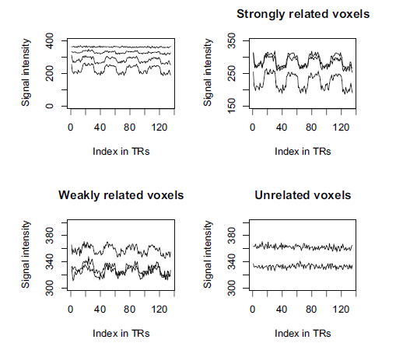
Block Design: Basic Analysis
3
3
2

Slide 8
Block Design: Basic Analysis
At voxel i the amount of activation,
is the average level of activation in voxel I over all times during task
is the average level of activation in voxel I over all times during rest or control

Slide 9
Block Design: Basic Analysis
Statistical parametric map → give threshold to determine which voxels should be declared “active”
Remark:
more than one task condition → generate an F statistic → F map for each subject → threshold

Slide 10
Block Design: Basic Analysis
Strong assumptions:
Normality
Independence of voxels (spatial independence → NOT realistic ☹)
Independence in time (temporal independence → NOT realistic either ☹)
Onset of the hemodynamic response is immediate upon stimulus presentation and it likewise stops immediately when the stimulus is stopped
Equal variances in task and control conditions
Will be violated in all fMRI data sets

Slide 11
Block Design: Basic Analysis
The Welch test (1937)
Permit the population variances to be different
The Cressie-Whitford test (1986)
Allow for non-normality
Nonparametric statistics
Pros: Drop the normality assumption
Cons: DF are generally large

Slide 12
Block Design: Basic Analysis
Correlational analysis (1993)
At voxel i calculate
Voxels with a high positive value of r_{i} → ACTIVE
Voxels with no correlations → INACTIVE
Voxels with strong negative correlation → deactivated voxels → not of interest

Slide 13
Block Design: Basic Analysis
# of images in the task condition = # of images in the control condition → a balanced block design → t test and correlation test coincide after transforming r_{i ,}

Slide 14
Contents
Exploratory Data Analysis
Block Design: Basic Analysis
Event-Related Designs: Basic Analysis
The General Linear Model
Methods for Combining Subjects

Slide 15
Event-Related Designs: Basic Analysis
Major focus → Hemodynamic response function (HRF)
Two main tools: Trial averaging & function estimation
Trial averaging
Trials in an experiment are sorted according to type → obtain average fMRI time course as well as variance of a particular type of trial → activated voxels shall exhibit stereotypical behavior of the BOLD response
BOLD: Blood Oxygenation Level Dependent
（血氧水平依赖）

Slide 16
Event-Related Designs: Basic Analysis
Trial averaging – not based on model or assumptions
Function estimation – obtain an estimate of the HRF that is model-based
Parametric vs Nonparametric approaches

Slide 17
Event-Related Designs: Basic Analysis
5.3.1 Parametric Approaches to the Estimation of the HRF
Model the shape of the BOLD response curve
✗ Poisson | ✓ Gamma
Friston et al., 1994 | Lange & Zeger, 1997
Less flexible – only has one parameter | More flexible – has two parameters
Discrete – BOLD response evolves continuously | Continuous

Slide 18
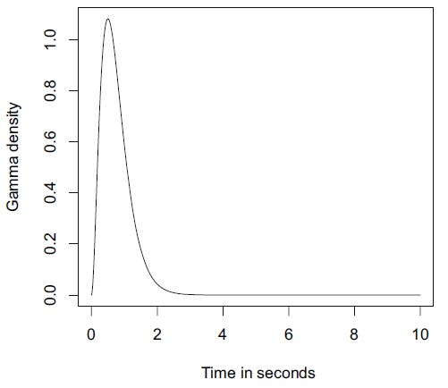
Event-Related Designs: Basic Analysis
5.3.1 Parametric Approaches to the Estimation of the HRF
(a) Model the HRF at time t and voxel i by a simple two-parameter gamma family:
a =3, b = 4

Slide 19
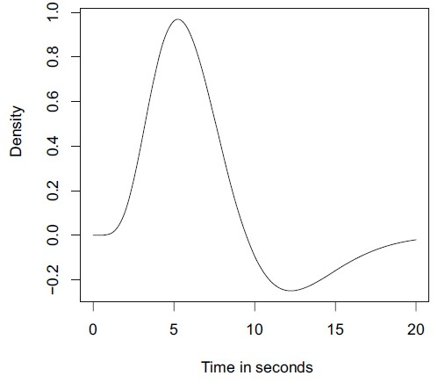
Event-Related Designs: Basic Analysis
5.3.1 Parametric Approaches to the Estimation of the HRF
(b) Some finer details cannot be easily modeled → modification:
τ_{j}=0.9δ_{j}, δ₁=6, δ₂=12, c=0.35

Slide 20
Event-Related Designs: Basic Analysis
5.3.1 Parametric Approaches to the Estimation of the HRF
(c) Estimating parameters can be difficult → Gaussian model (Rajapske et al.,1998):
Pros: lag & dispersion are independent
Cons: symmetry of Gaussian curve does not correspond to the supposed response, nor can it account for the often-observed undershoot

Slide 21
Event-Related Designs: Basic Analysis
5.3.1 Parametric Approaches to the Estimation of the HRF
Subsume approaches into one general, nonlinear model (Kruggel & von Cramon, 1999)
s-voxel; t-time
N(0, Σ)
Separating Σ into temporal and spatial parts & assuming each of these has an AR(1) structure

Slide 22
Event-Related Designs: Basic Analysis
5.3.2 Nonparametric Approaches to the Estimation of the HRF
Drawbacks of parametric approaches:
assume HRF has the same form at each voxel, under all conditions, and for all subjects
imposing a priori and arbitrarily shape to the HRF

Slide 23
Event-Related Designs: Basic Analysis
5.3.2 Nonparametric Approaches to the Estimation of the HRF
Random effect polynomial regression with one effect for each voxel (Gibbons et al., 2004):
y_{i} is the time averaged time course for the ith voxel
W_{i} is the known design matrix for the fixed effects
X_{i} is the known design matrix for the random effects
α, β_{i} are the unknown parameters
X_{i} ~ N(0,Σ_{β})
Cov(ε_{i} ) = σ_{ε}²Ω_{i}

Slide 24
Event-Related Designs: Basic Analysis
5.3.2 Nonparametric Approaches to the Estimation of the HRF
Estimates:
Random
effect coef
Voxel-level coef
Fixed effect coef
Population var
Scale factor of error term

Slide 25
Event-Related Designs: Basic Analysis
5.3.2 Nonparametric Approaches to the Estimation of the HRF
Avoid both trial averaging and specifying a form for HRF (Burock & Dale, 2000)
Write the observed fMRI signal for a given voxel at time t (considered as discrete)
x_{i} is a dummy variable representing the trial type
h_{i} is the hemodynamic response associated with the ith trial type
ε is noise, normally distributed but with arbitrary cov matrix

Slide 26
Event-Related Designs: Basic Analysis
5.3.2 Nonparametric Approaches to the Estimation of the HRF
OLS estimate:
Calculate residuals:
Use e to estimate Σ_{ε} “global” estimate
“local” estimate
Burock and Dale assume a mixture of white (uncorrelated) Gaussian noise and a correlated (autoregressive) component.

Slide 27
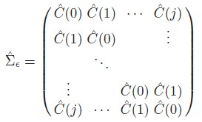
Event-Related Designs: Basic Analysis
5.3.2 Nonparametric Approaches to the Estimation of the HRF
Final estimate of the hemodynamic response is,
A component of the covariance matrix at lag k
j represents the biggest time lag considered

Slide 28
Event-Related Designs: Basic Analysis
5.3.2 Nonparametric Approaches to the Estimation of the HRF
A Bayesian extension of this approach (Marrelec, 2003)
n = K +1, . . .,N
Target of estimation: the h elements make up the hemodynamic response

Slide 29
Event-Related Designs: Basic Analysis
5.3.3 Methods for Estimating the Delay of the Hemodynamic Response
Length of the delay in the BOLD response
Reasons: MAYBE physiological or fMRI noise.
Saad et al. → a simple visual processing task
Detect which voxels were activated by the stimulus → estimate the delay in the response relative to the stimulus → calculate the lagged correlation coef between fMRI time course and a reference time course

Slide 30
Event-Related Designs: Basic Analysis
5.3.3 Methods for Estimating the Delay of the Hemodynamic Response
Reference time series:
The lagged model:
Correlation coef between r(t) and f(t)

Slide 31
Contents
Exploratory Data Analysis
Block Design: Basic Analysis
Event-Related Designs: Basic Analysis
The General Linear Model
Methods for Combining Subjects

Slide 32
The General Linear Model
The foundation of most traditional statistical analysis of fMRI data.
Y_{t×v} will be a matrix representing the time courses of all the voxels (t-time; v-voxels)
X will be a design matrix reflecting the stimuli presented at each point in time
ε may have constant or nonconstant variance, as well as nonzero covariance terms.
Estimates of β can be obtained via OLS

Slide 33
The General Linear Model
h(·) is the model for the HRF and s(t−·) the stimulus time series. The value of the covariate at the ith scan is x(ti), with t_{i} the time of the image acquisition.

Slide 34
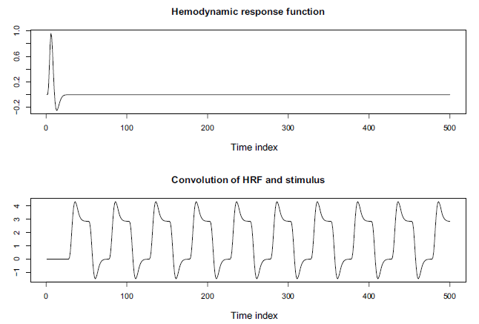
The General Linear Model

Slide 35
The General Linear Model
Basic assumptions
Voxels are independent
Time points are independent
The error variance at each time point (experimental condition) is the same
The same model, as given by the design matrix, is appropriate for every voxel in the brain
Almost surely unrealistic → improving and extending the general linear model or alternate analysis paths → subsequent chapters

Slide 36
The General Linear Model
Some Implementation Issues
(a) modifying the predictor variables to improve inference
Incorporating the first temporal derivative of the convolved HRF into the model as an additional predictor (Friston et al., 1998)

Slide 37
The General Linear Model
Some Implementation Issues
Testing the effect of β1 while directly accounting for the effect of temporal derivative as well
e is the residual error; τ is the critical value of the new t test
Delay increase → the ability of the nonderivative term to capture important features decrease → include additional derivatives

Slide 38
The General Linear Model
Some Implementation Issues
(b) fixed, random or mixed effect models
Adding indicators for group membership → examine differences between experimental groups → QUESTION: whether they should be considered as FIXED or RANDOM effects??
Common solutions in fMRI research:
sessions or subjects → random effects;
effect of experimental manipulation → fixed effects

Slide 39
The General Linear Model
Some Implementation Issues
(c) analysis in “real time”
Advantage: the quality of the data can be assessed as it is being collected and changes can be made to experimental paradigm
1st step of the algorithm: use Gram-Schmidt orthogonalization to transform original linear model

Slide 40
The General Linear Model
Some Implementation Issues
(c) analysis in “real time”
Interested in β coef → Estimating α coef

Slide 41
Contents
Exploratory Data Analysis
Block Design: Basic Analysis
Event-Related Designs: Basic Analysis
The General Linear Model
Methods for Combining Subjects

Slide 42
Methods for Combining Subjects
Two fundamental questions:
Finding a common space on which to consider the maps
Finding a “statistical optimal” way to combining the data from the subjects in the study
Computational efficiency & speed
Good small sample properties
Effective use of the data
Robustness

Slide 43
Methods for Combining Subjects
5.5.1 The Anatomical Question
Talairach and Tournoux system
Individual subjects
images
Identify certain landmarks in the brain by hand, feed coordinates into the program
Talairach Space
Human intervention
Talairach System -- Transformation

Slide 44
Methods for Combining Subjects
5.5.1 The Anatomical Question
Another popular atlas → Montreal Neurological Institute (MNI) brain → based on a large number of living brains
Has been adopted by the International Consortium of Brain Mapping (ICBM) as its standard

Slide 45
Methods for Combining Subjects
5.5.2 The Statistical Question
Combining information from independent sources
Two Types of combining procedures: combining tests & combined estimation
Combining tests: comprising methods that are based on individual test statistics: p-value techniques

Slide 46
Methods for Combining Subjects
5.5.2 The Statistical Question
The most popular: Fisher (1950)
k subjects, p_{i} is the p-value associated with the ith test
Large values of T_{F}, when calibrated against the appropriate χ² distribution, lead to rejection of the null hypothesis (no activation in imaging studies)
~ χ²(2k)

Slide 47
Methods for Combining Subjects
5.5.2 The Statistical Question
Other p-value techniques:
Tippett (1931): T_{T} =min_{1<=i<=k} p_{i}
Reject if T_{T} < 1-(1-α)^{1/k}
Wilkinson (1951): looking at the rth smallest p-value
Reject if p_{r} < a constant depends on k, r and α
Worsley & Friston (2000): T_{W} =max_{1<=i<=k} p_{i}
Reject if Tw < α^{1/k}

Slide 48
Methods for Combining Subjects
5.5.2 The Statistical Question
Lazar (2002) : Commonly used in the neuroimaging community
T_{i} is the value of the t statistics calculated for subject i at a particular voxel
Reject for large values of T_{A}, compared to percentiles of N(0,1)

Slide 49
Methods for Combining Subjects
5.5.2 The Statistical Question
Combined estimation: model-based, rely on the linear model
Fixed effect model:
yi – the effect observed in the ith study, θ is the common mean, and ε_{i} is the error.
Defining the weight wi to be inversely proportional to the variance in the ith study

Slide 50
Methods for Combining Subjects
5.5.2 The Statistical Question
is unbiased for θ, has estimated variance 1/Σw_{i}, and is approximately normally distributed
Test for H₀: θ = 0
Reject for large values of T_{X}

Slide 51
Methods for Combining Subjects
5.5.2 The Statistical Question
Random effect model
ε_{i} ~N(0, V_{i}), e_{i} ~N(0, σ_{θ}²) and all the e_{i}, i are independent of each other

Slide 52
Methods for Combining Subjects
5.5.2 The Statistical Question
Estimate:
Two components of variance:
Test statistics:
Reject for large T_{R}

Slide 53
Methods for Combining Subjects
5.5.2 The Statistical Question
Remarks:
Standard errors of the fixed effect estimate tend to be smaller than those for the random effect estimate
When σ_{θ}² is zero, the two models coincide →the fixed effect model = “optimistic scenario” relative to the random effect model.

Slide 54
Methods for Combining Subjects
5.5.2 The Statistical Question
Other statistical questions
Spatial Smoothing
Introducing even a small amount of smoothing has several effects:
first, the discrete regions merge;
second, activation on the dominant side of the brain is mirrored by activation in the other hemisphere (something that is not detected when no smoothing is applied);
third, the intensity of the activation in the discovered region increases.

Slide 55
Methods for Combining Subjects
5.5.2 The Statistical Question
Other statistical questions
Whether subjects are homogenous enough?
RV coefficient (Robert & Escoufier, 1976)
When the matrices for the two subjects are similar (linearly related), the value of the RV coefficient will be close to 1;
when the matrices differ greatly, the coefficient will be close to zero.

Slide 56
The End

