Slide 1
An entropy-based approach to interpreting ultrasound signals
M.S. Hughes, J.E. M^{c}Carthy, J.N. Marsh, S.A. Wickline
St. Louis Machine Learning and Data Science Meet-up
December 16, 2015

Slide 2
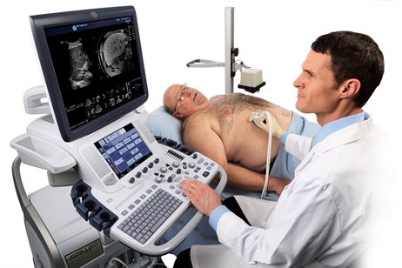
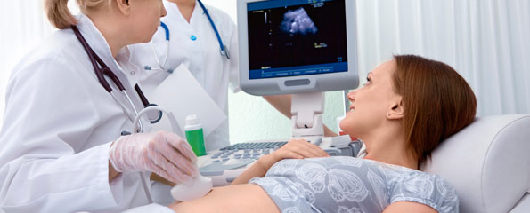

Slide 3
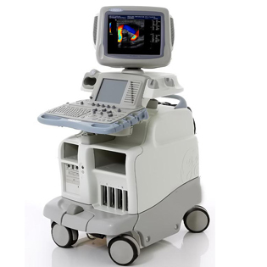
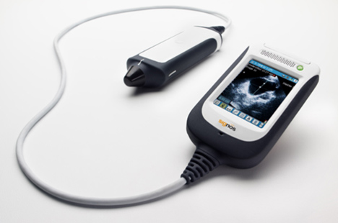
$26,000
$6,500

Slide 4
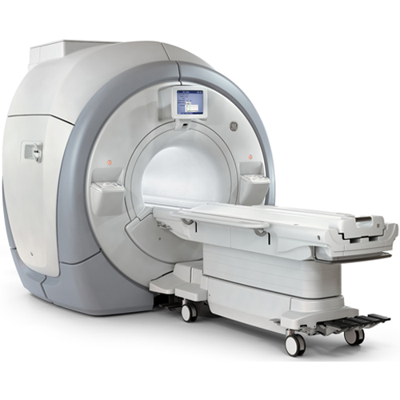
$3,500,000
Notes:
GE Optima MR450W – this is super high end.

Slide 5
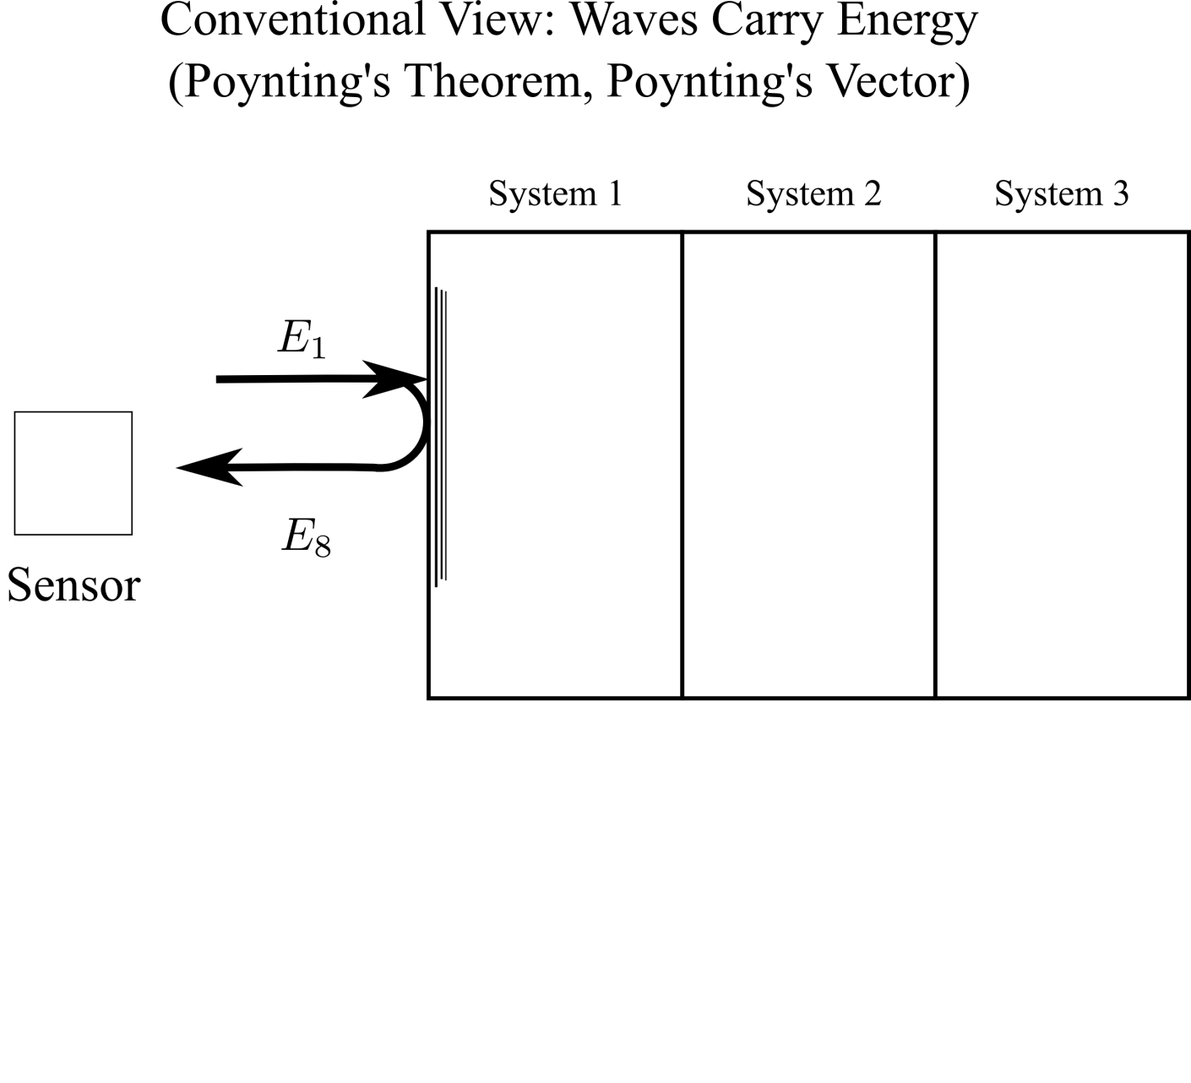

Slide 6
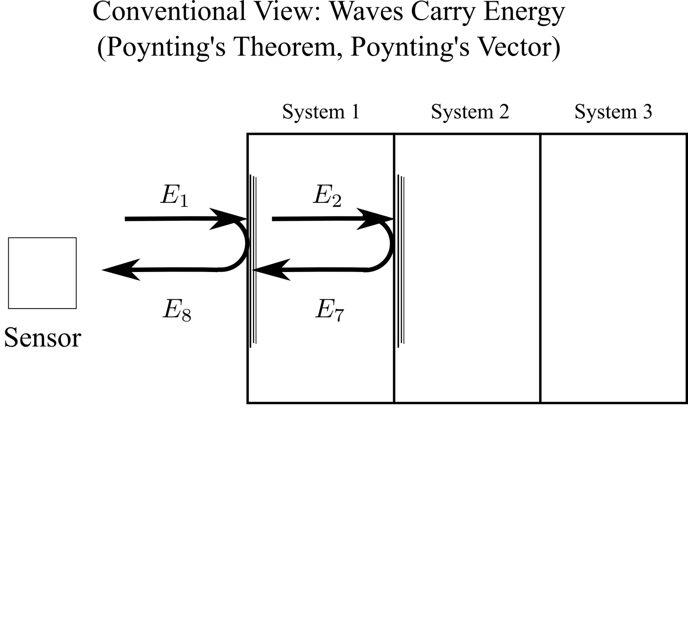

Slide 9
Notes:
Say the waveform was sampled much more finely than the interval t_f-t_i, i.e., it was highly oversampled relative to the width of the time window shown here

Slide 15
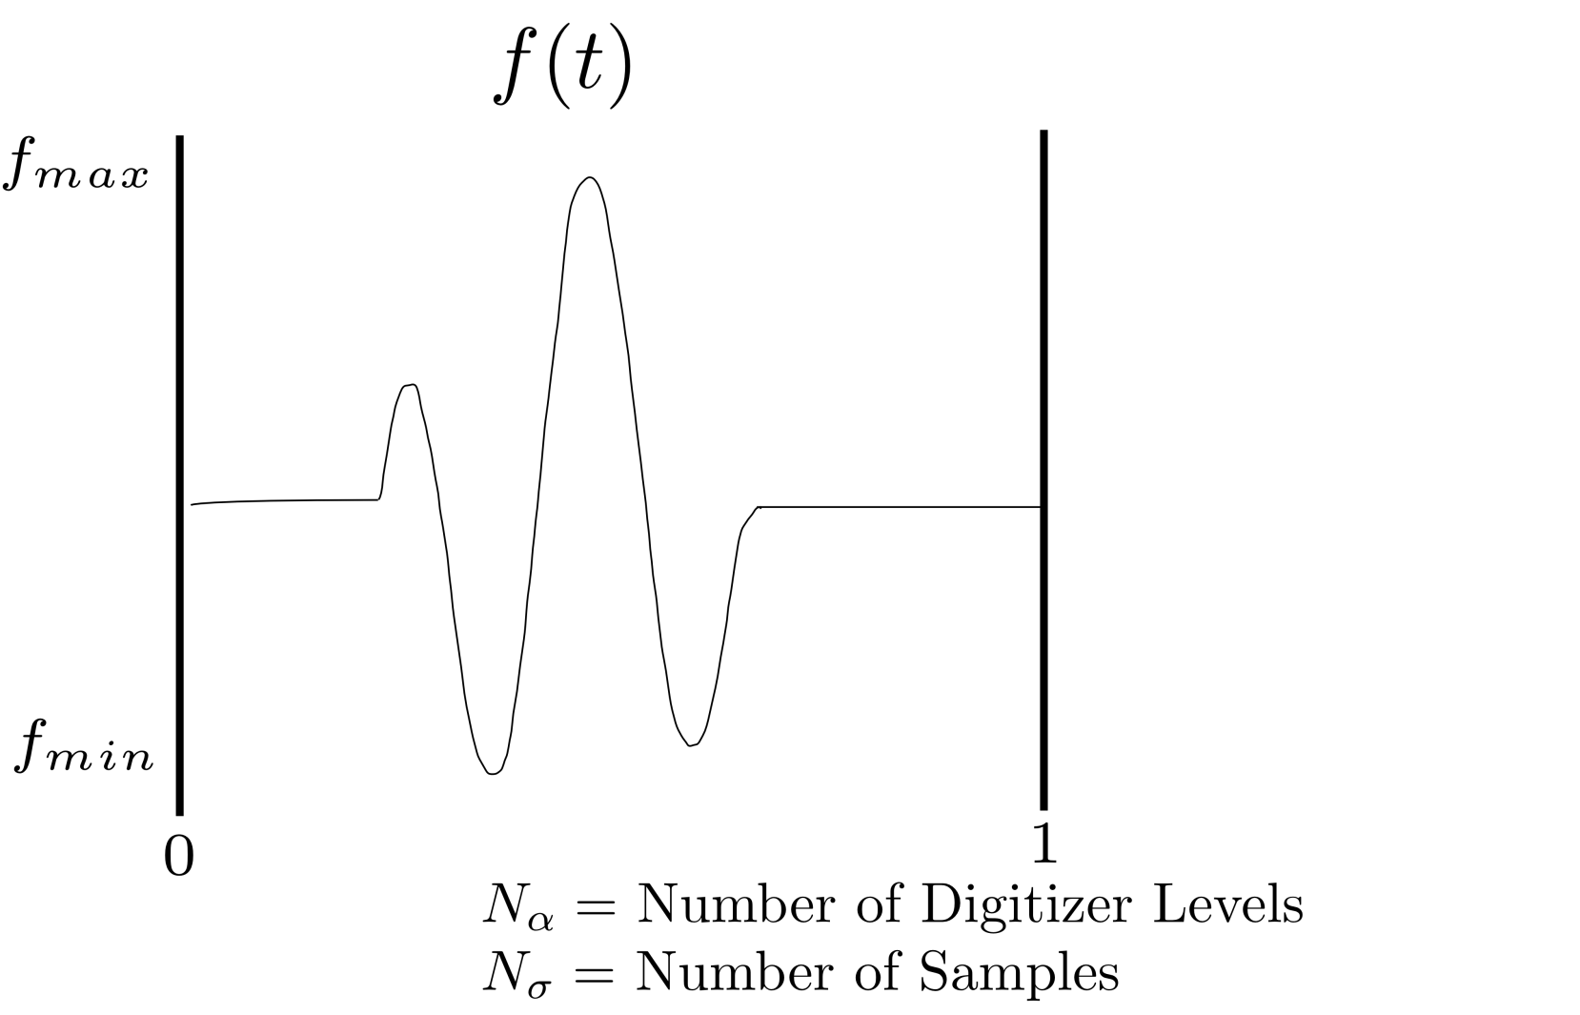
Calculation of Entropy

Slide 16
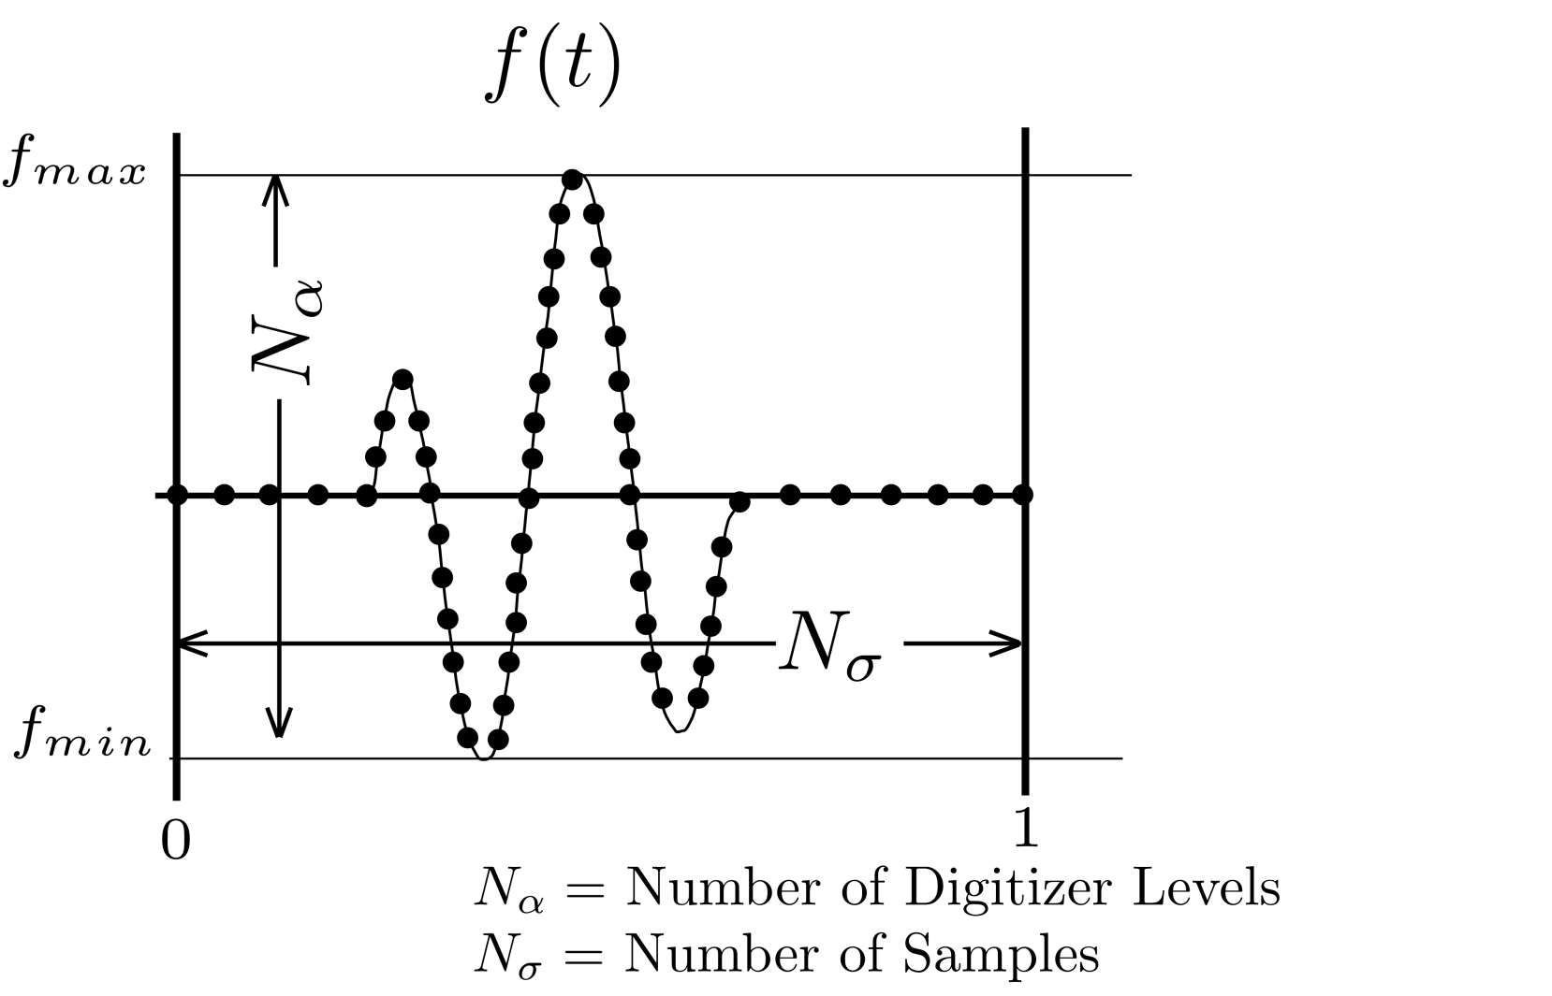
Calculation of Entropy

Slide 17
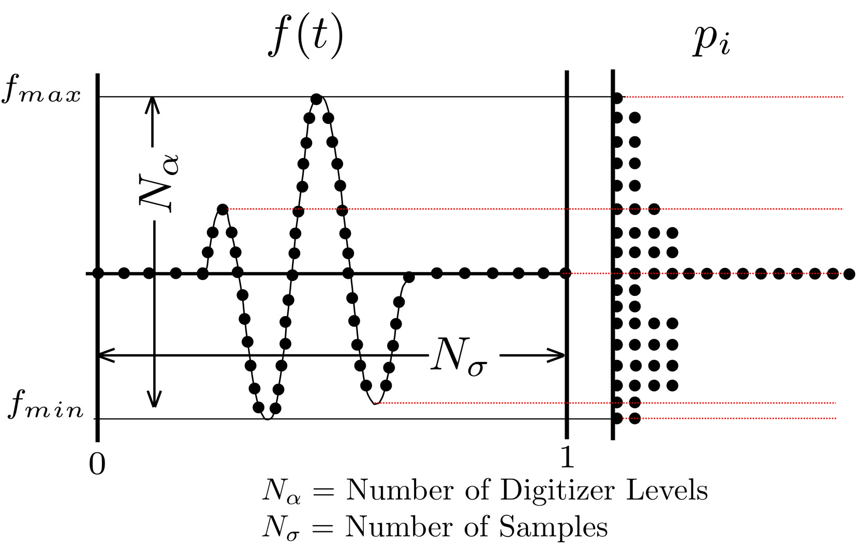
Calculation of Entropy

Slide 18
Calculation of Shannon Entropy

Slide 19
Continuous Version of Shannon Entropy

Slide 20
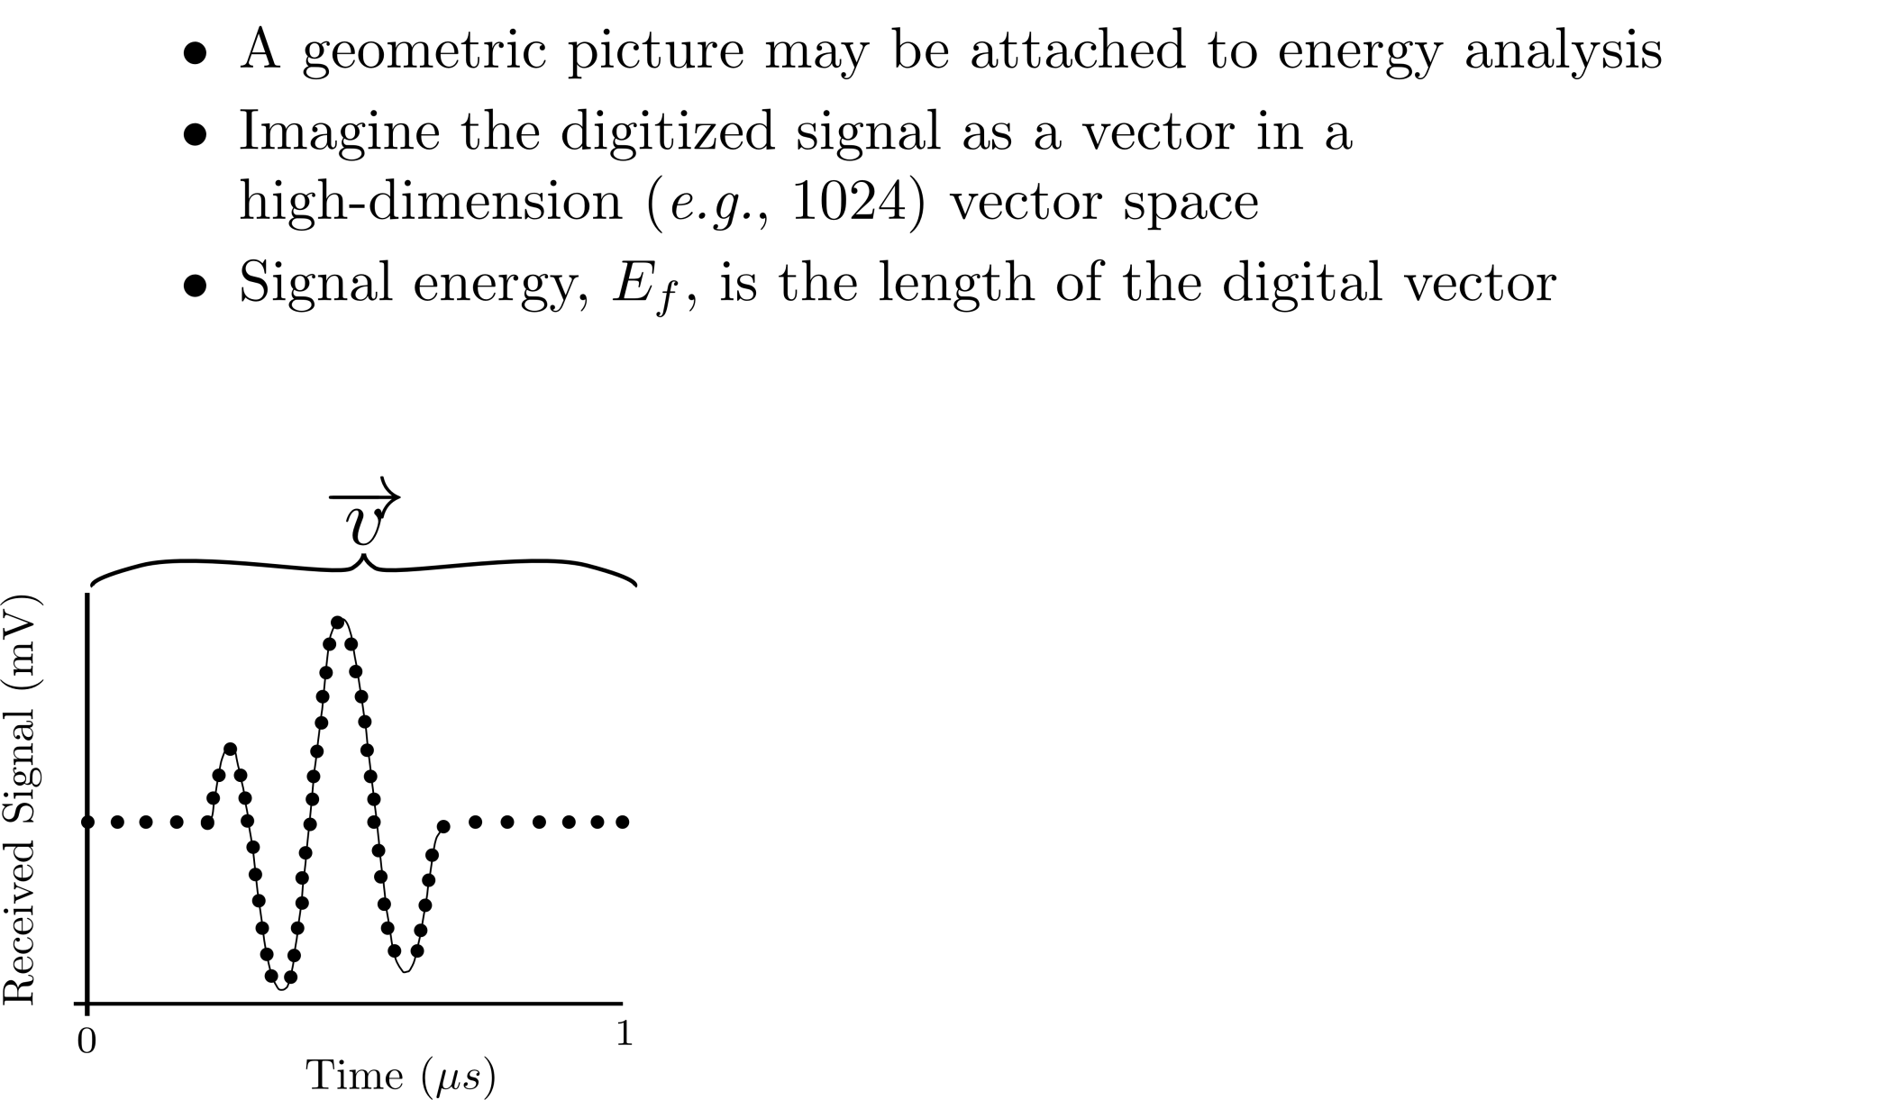
Geometric Interpretation of Entropy and Energy

Slide 21
Geometric Interpretation of Entropy and Energy

Slide 22
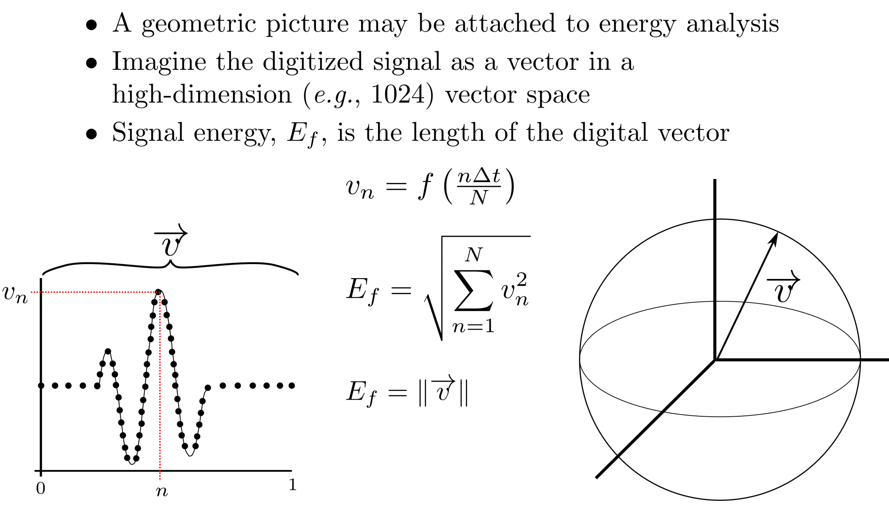
Geometric Interpretation of Entropy and Energy

Slide 23
Geometric Interpretation of Entropy and Energy
Notes:
Say: “or a Log length, if we’re talking about Log Energy”

Slide 24
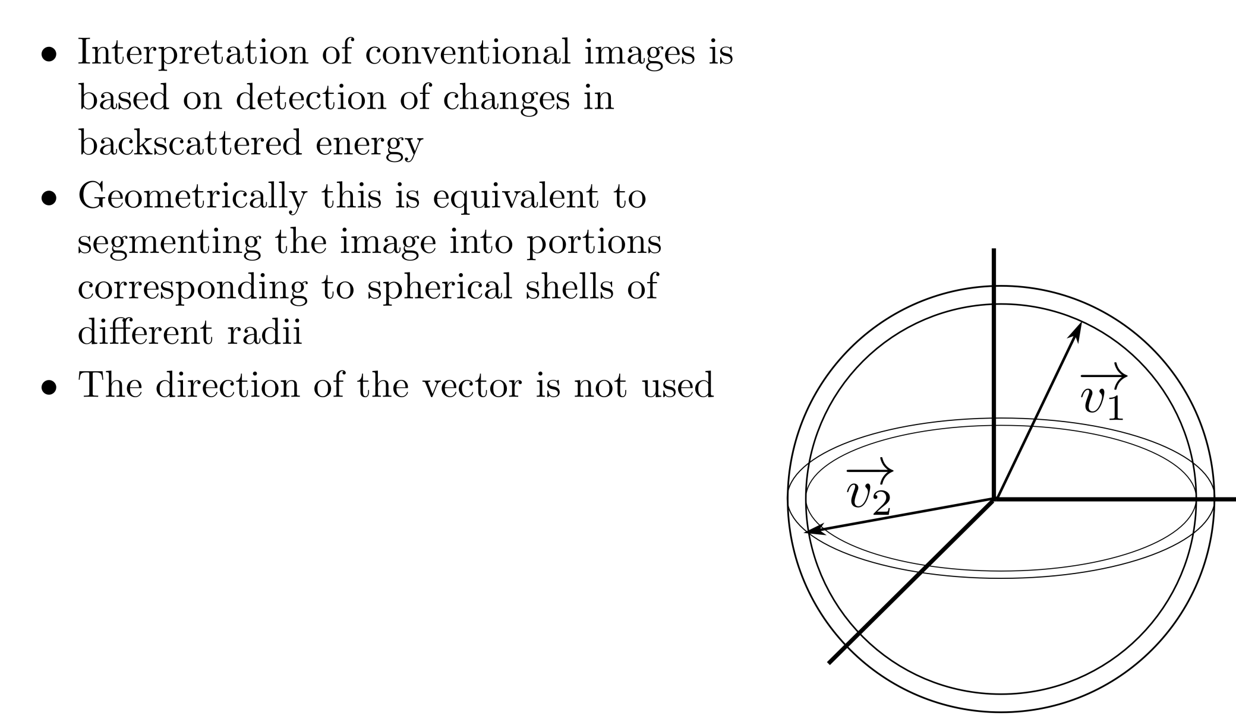
Signal Receiver Sensitivity

Slide 25
Signal Receiver Sensitivity
-

Slide 26
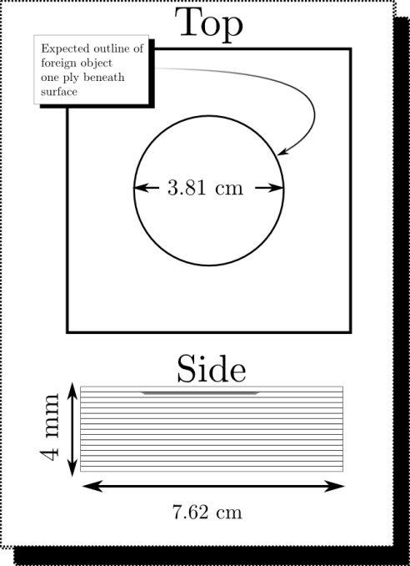
Non-destructive Evaluation of Graphite-Epoxy Composites
Materials Characterization: Entropy detects Flaws that are invisible to conventional techniques
All Processing is done independently on RF Segments
No Gates or Spatial Information is used

Slide 27
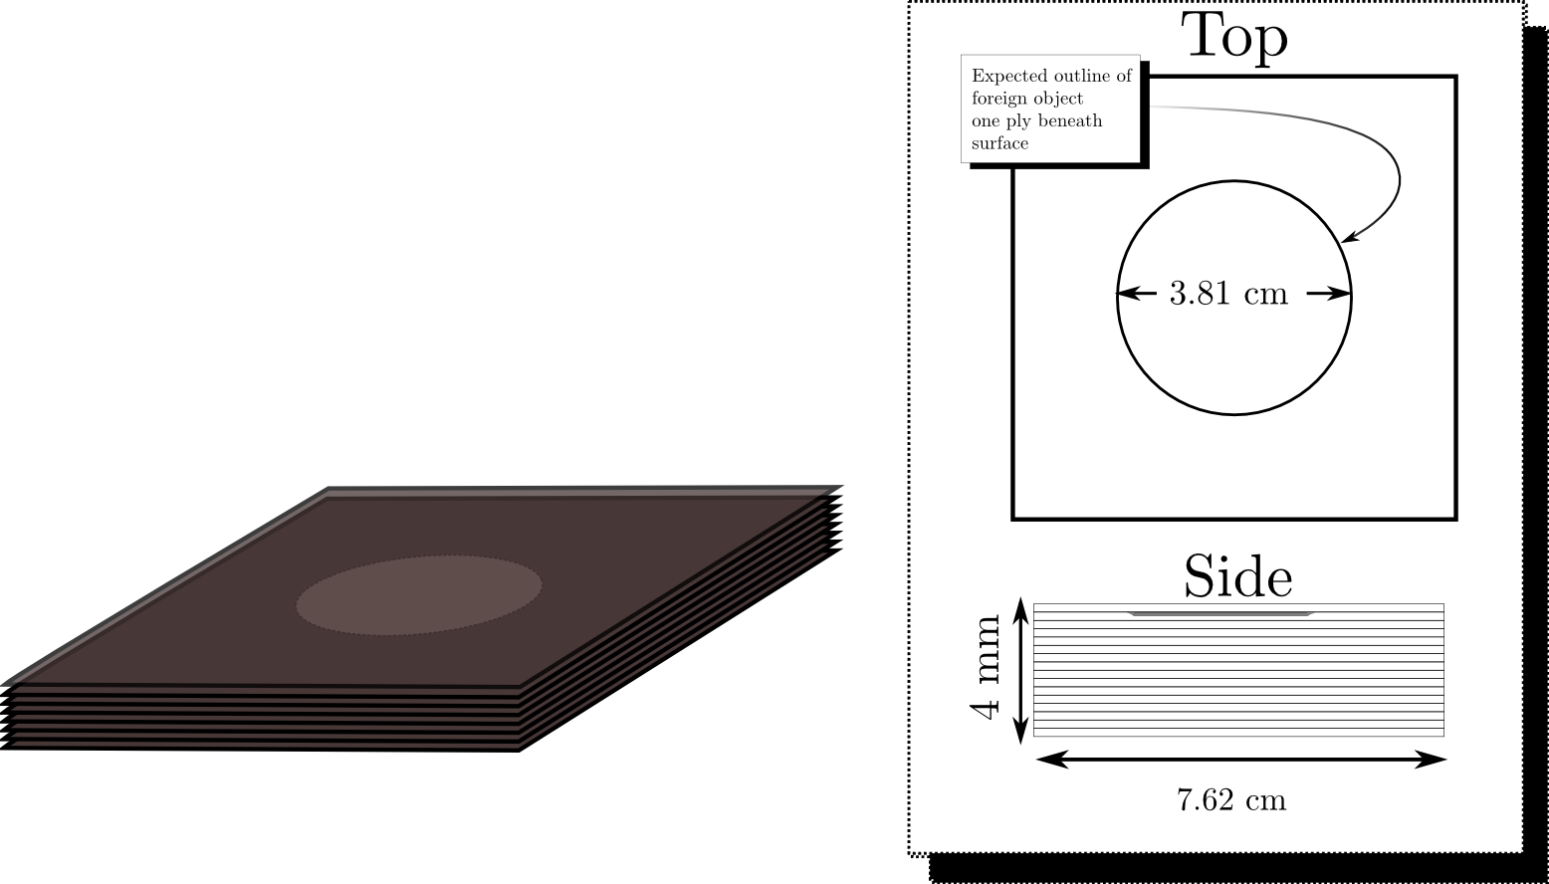
Non-destructive Evaluation of Graphite-Epoxy Composites
Materials Characterization: Entropy detects Flaws that are invisible to conventional techniques
All Processing is done independently on RF Segments
No Gates or Spatial Information is used

Slide 28
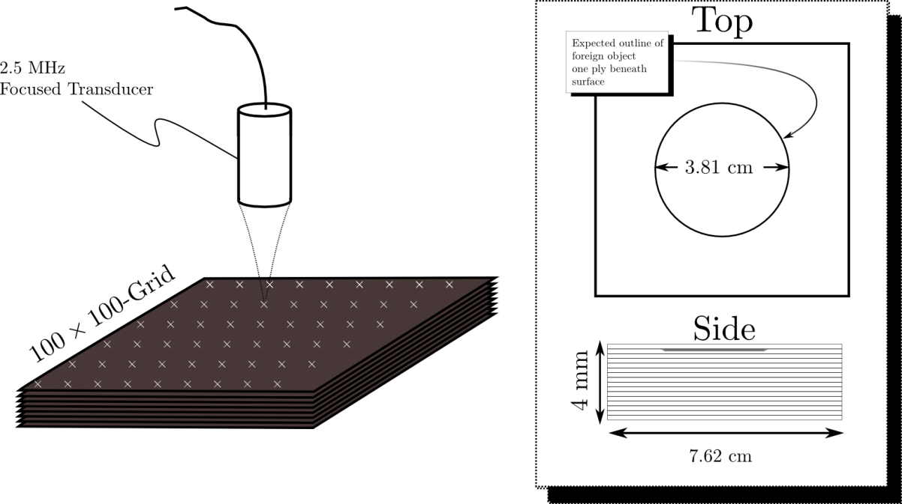
Non-destructive Evaluation of Graphite-Epoxy Composites
Materials Characterization: Entropy detects Flaws that are invisible to conventional techniques
All Processing is done independently on RF Segments
No Gates or Spatial Information is used

Slide 29
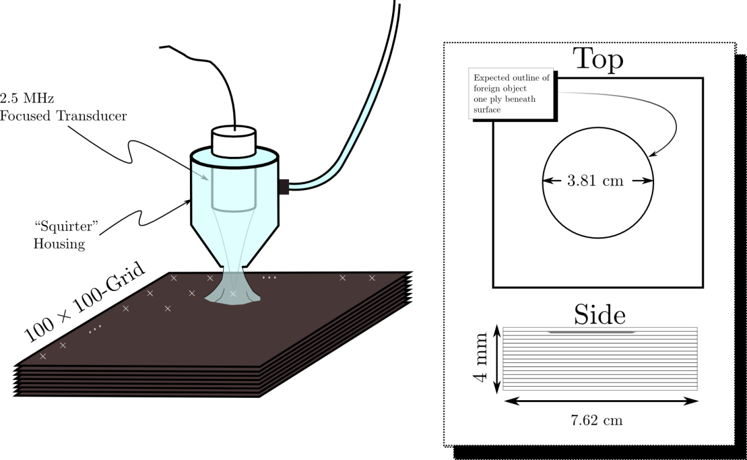
Non-destructive Evaluation of Graphite-Epoxy Composites
Materials Characterization: Entropy detects Flaws that are invisible to conventional techniques
All Processing is done independently on RF Segments
No Gates or Spatial Information is used

Slide 30
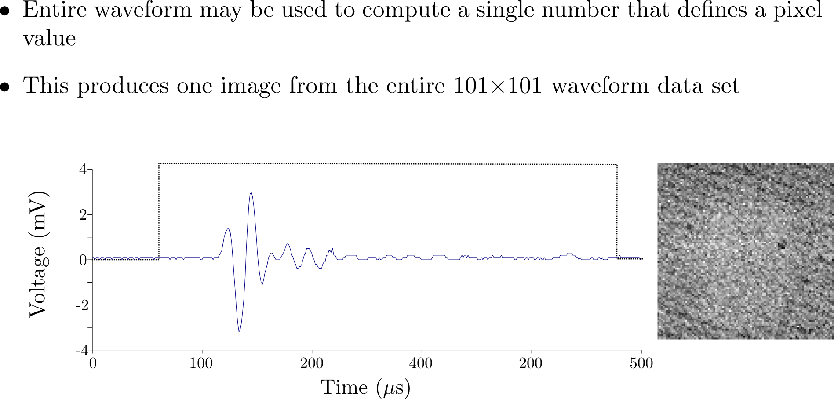
Analysis

Slide 31
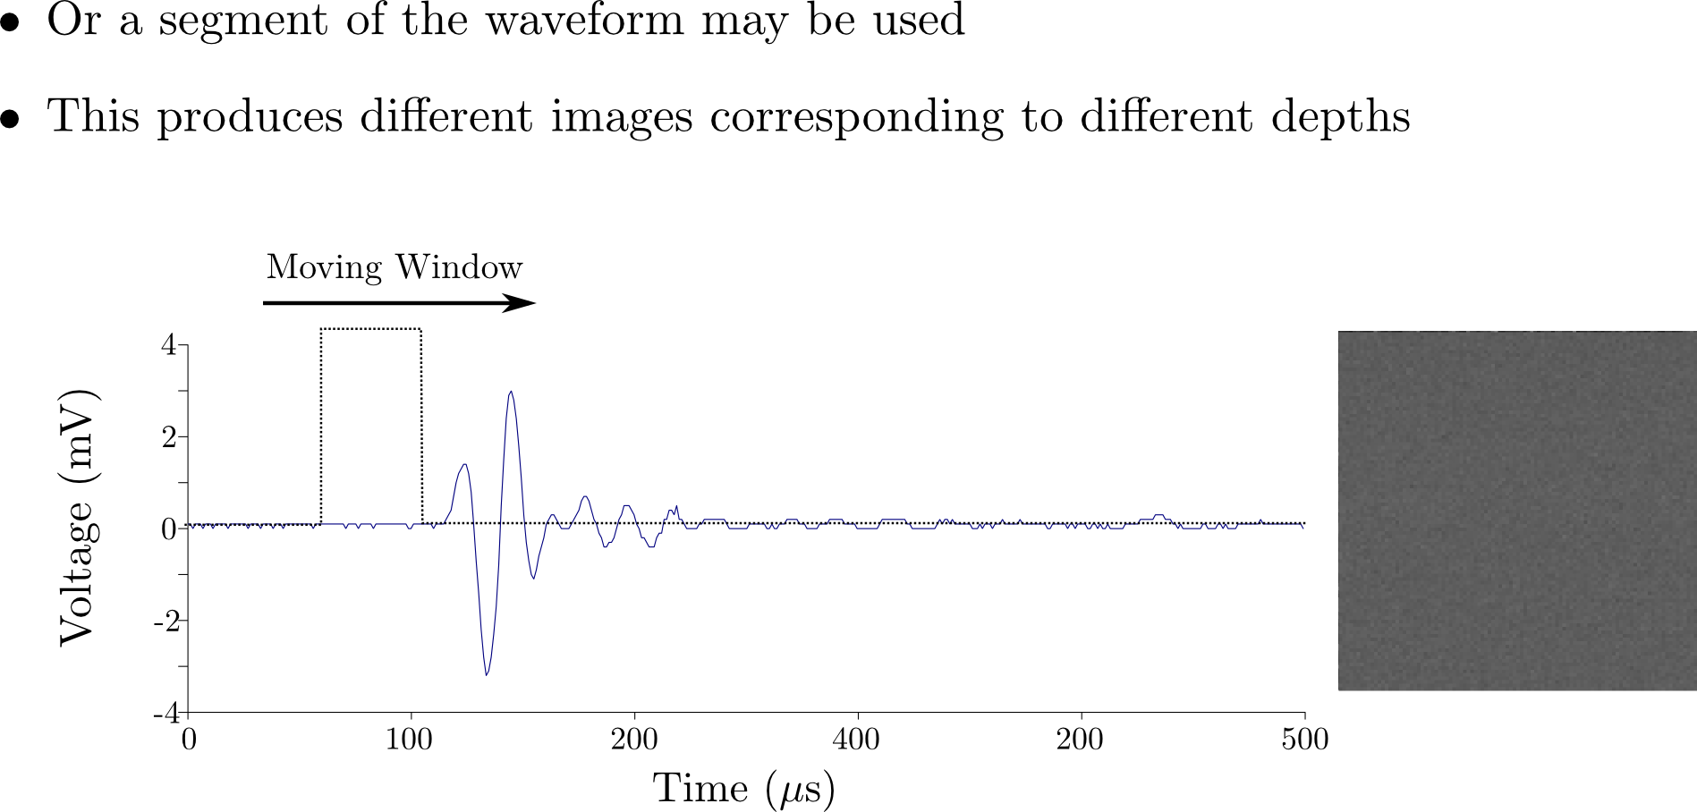
Analysis

Slide 32
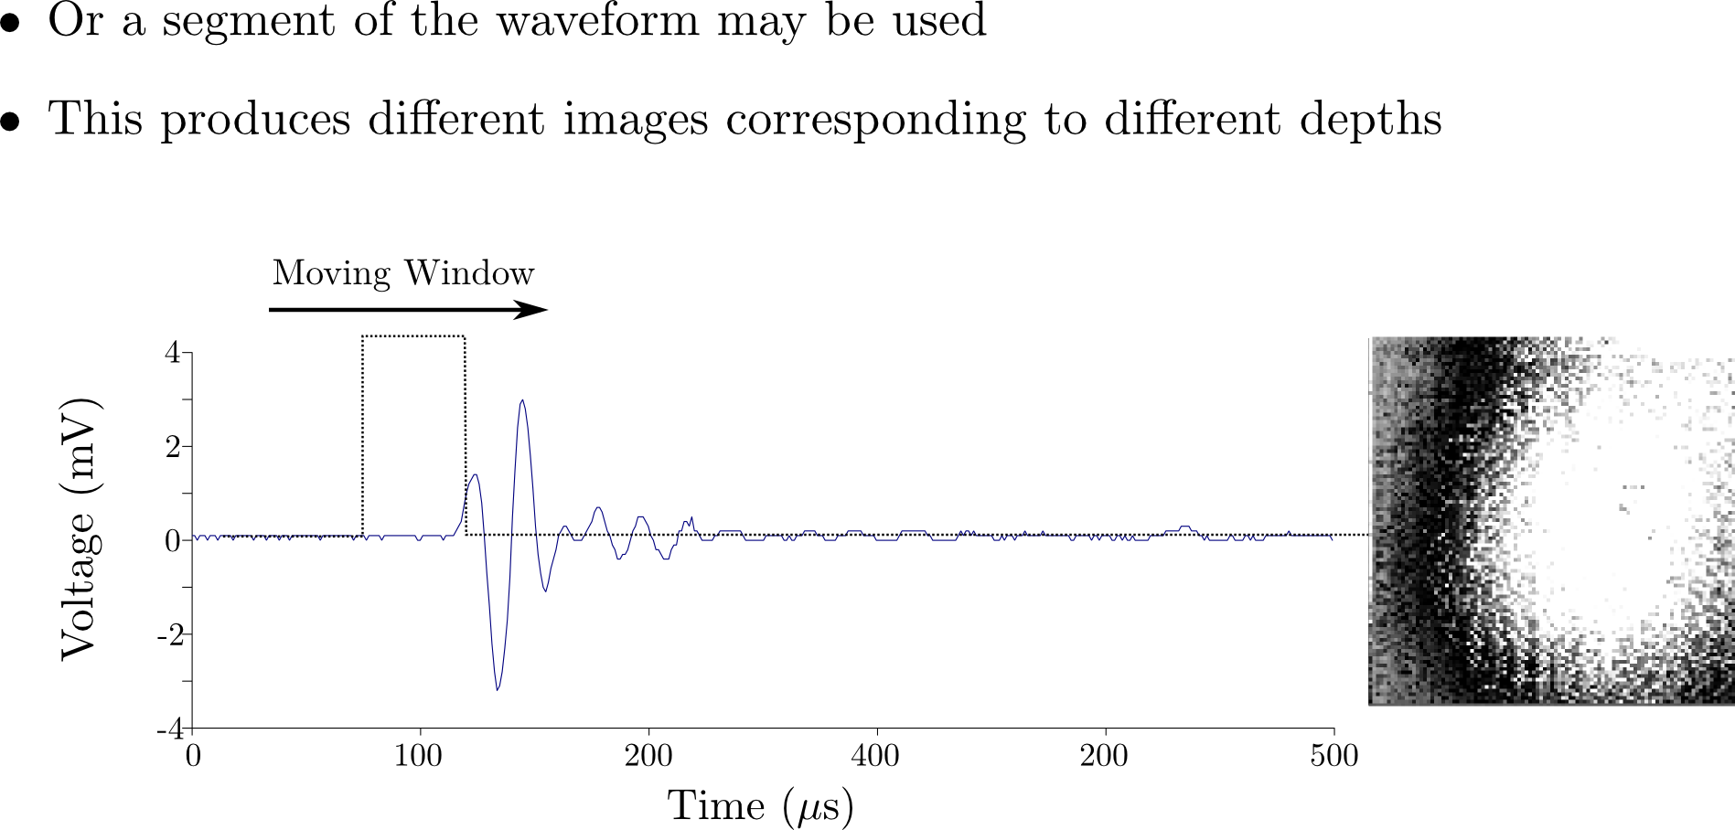
Analysis

Slide 33
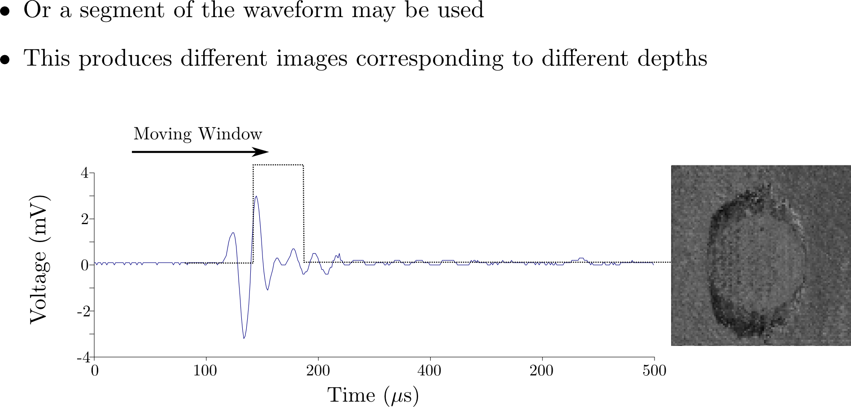
Analysis

Slide 34
Analysis

Slide 35
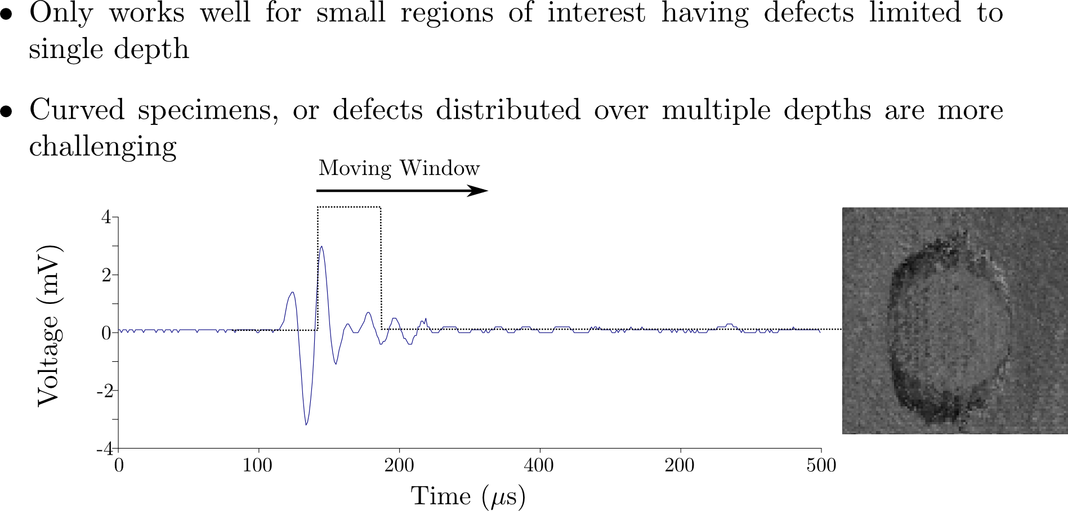
Analysis

Slide 36
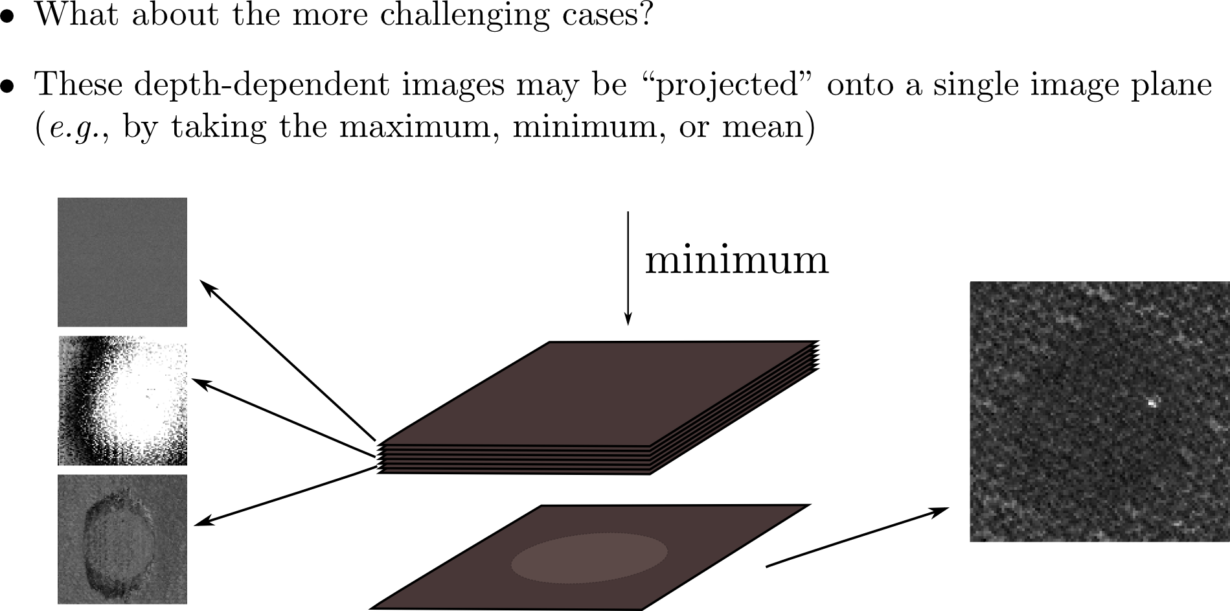
Analysis

Slide 37
Analysis

Slide 38
Analysis

Slide 39
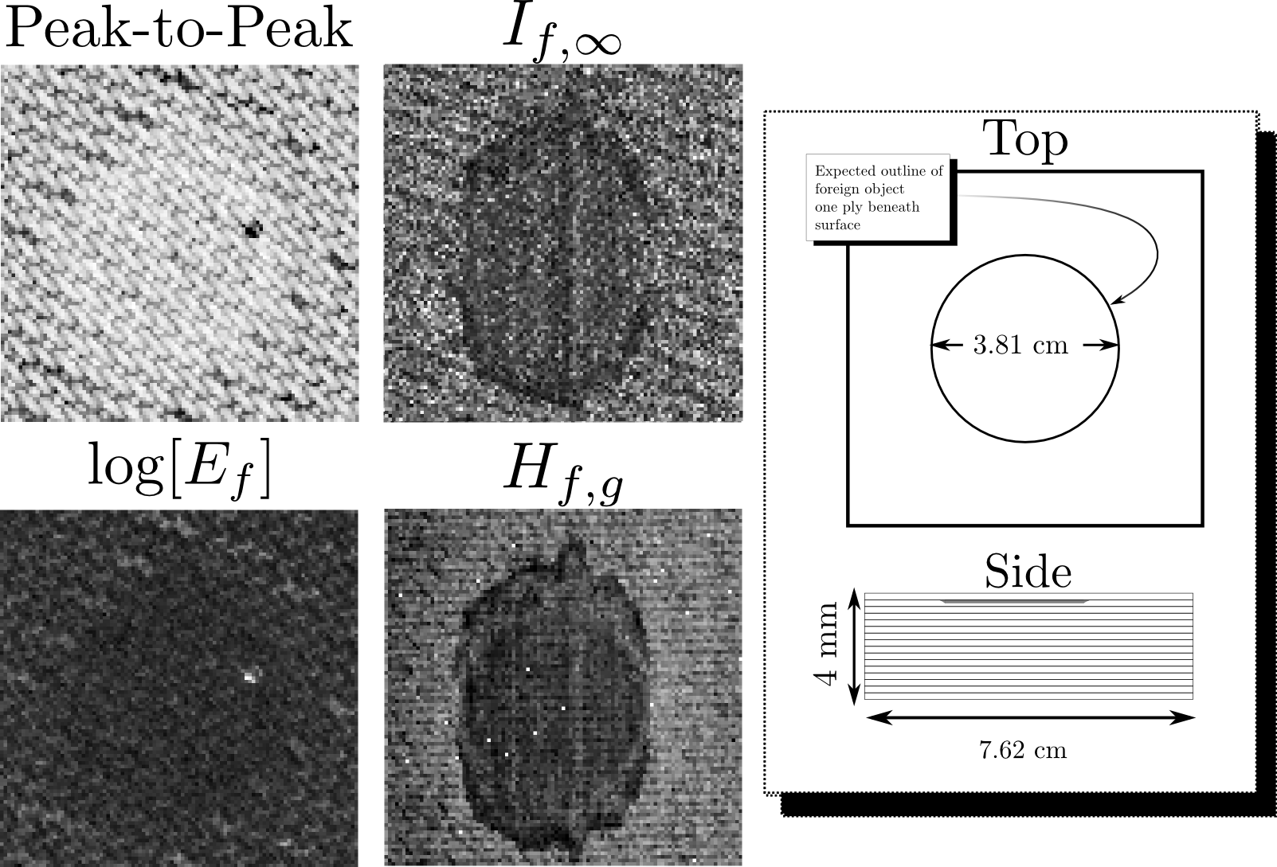
Non-destructive Evaluation of Graphite-Epoxy Composites
Materials Characterization: Entropy detects Flaws that are invisible to conventional techniques
All Processing is done independently on RF Segments
No Gates or Spatial Information is used
Notes:
Be sure to explain peak-to-peak

Slide 40
Non-destructive Evaluation of Graphite-Epoxy Composites
Materials Characterization: Entropy detects Flaws that are invisible to conventional techniques
All Processing is done independently on RF Segments
No Gates or Spatial Information is used

Slide 41
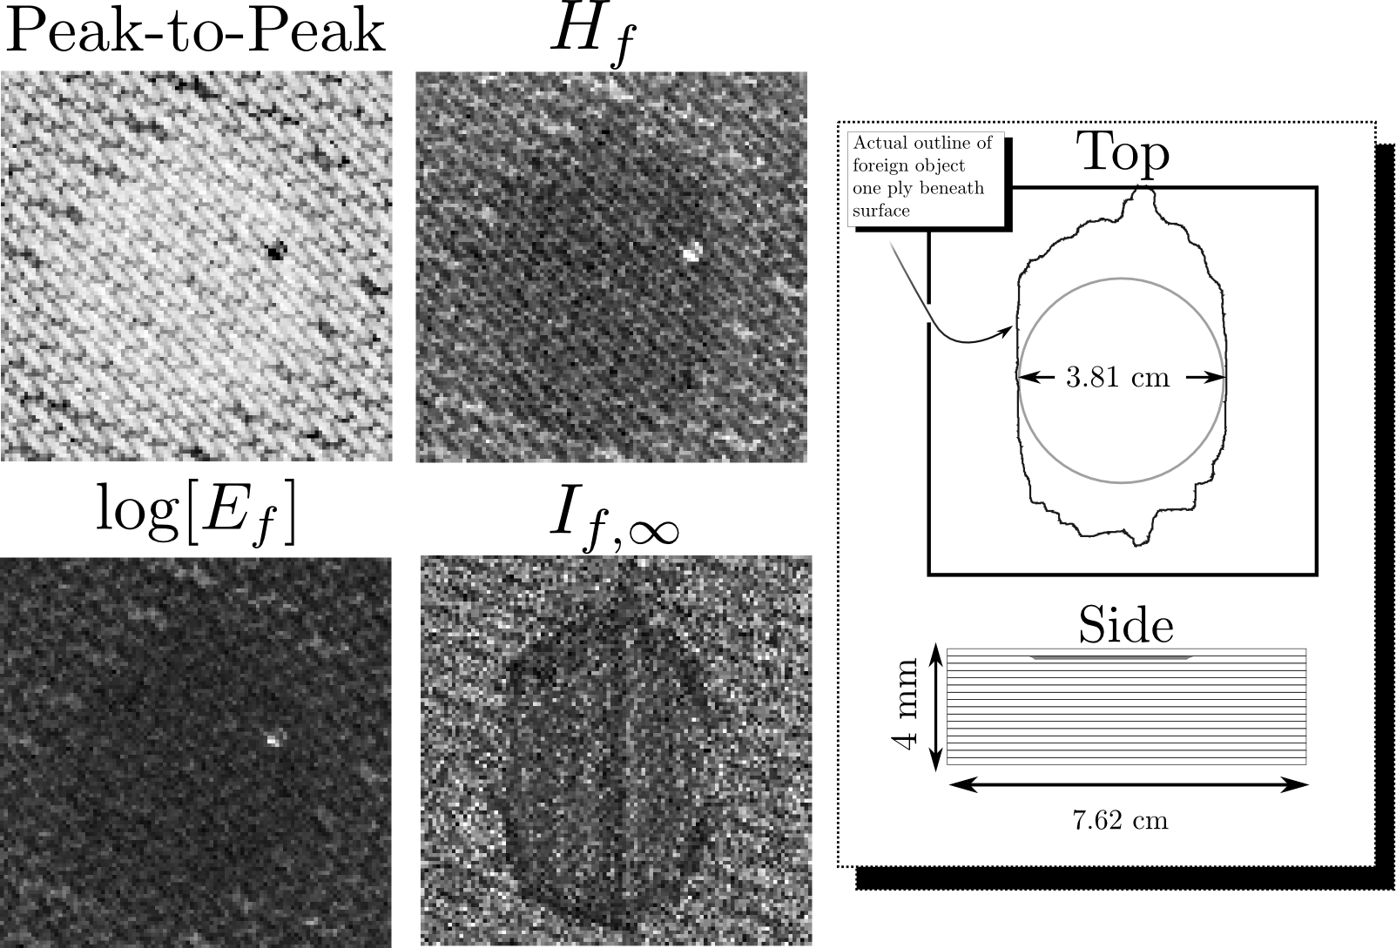
Non-destructive Evaluation of Graphite-Epoxy Composites
Materials Characterization: Entropy detects Flaws that are invisible to conventional techniques
All Processing is done independently on RF Segments
No Gates or Spatial Information is used

Slide 42
The Different Entropies

Slide 43
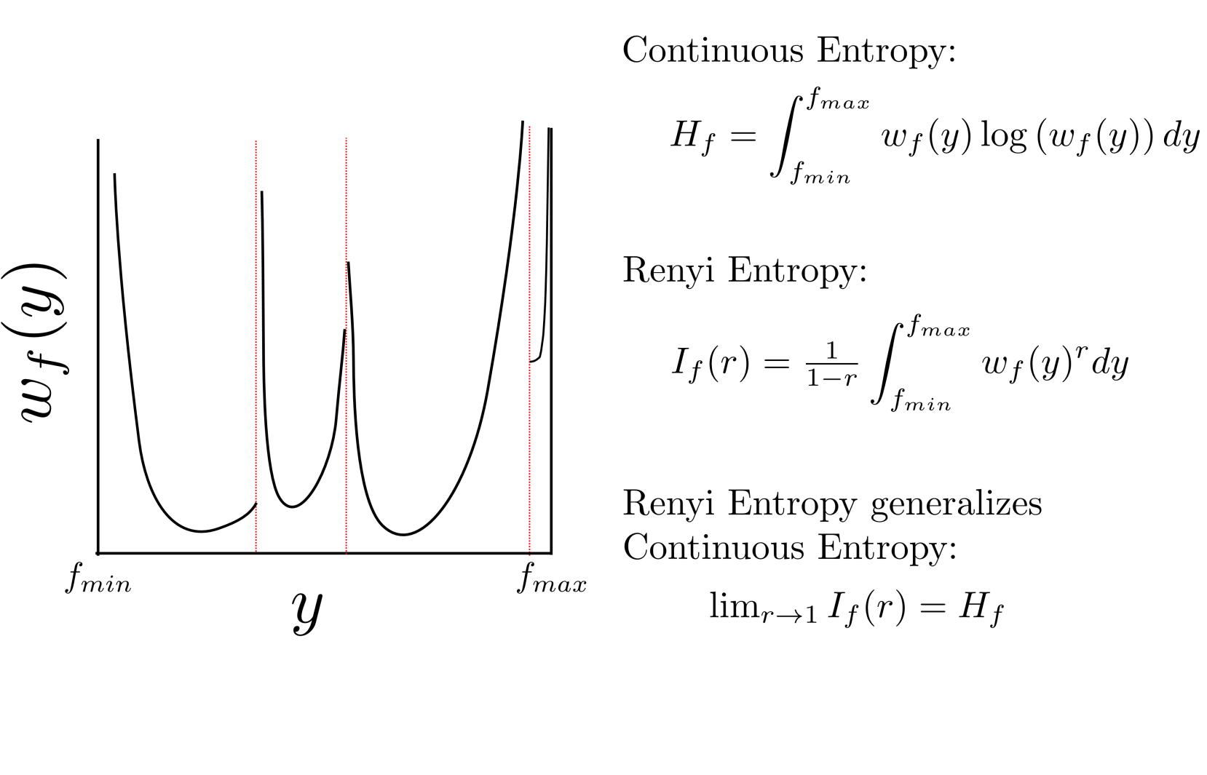
Entropy Calculations: Transition to Renyi Entropy

Slide 44
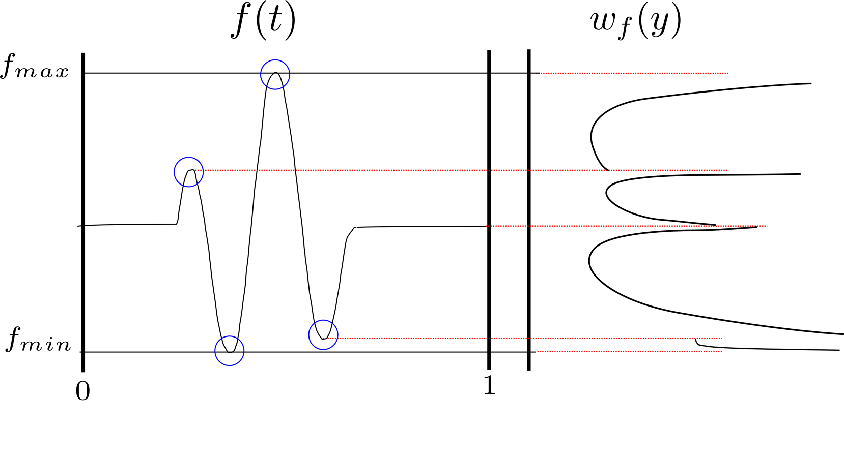
Density Function Singularities

Slide 45
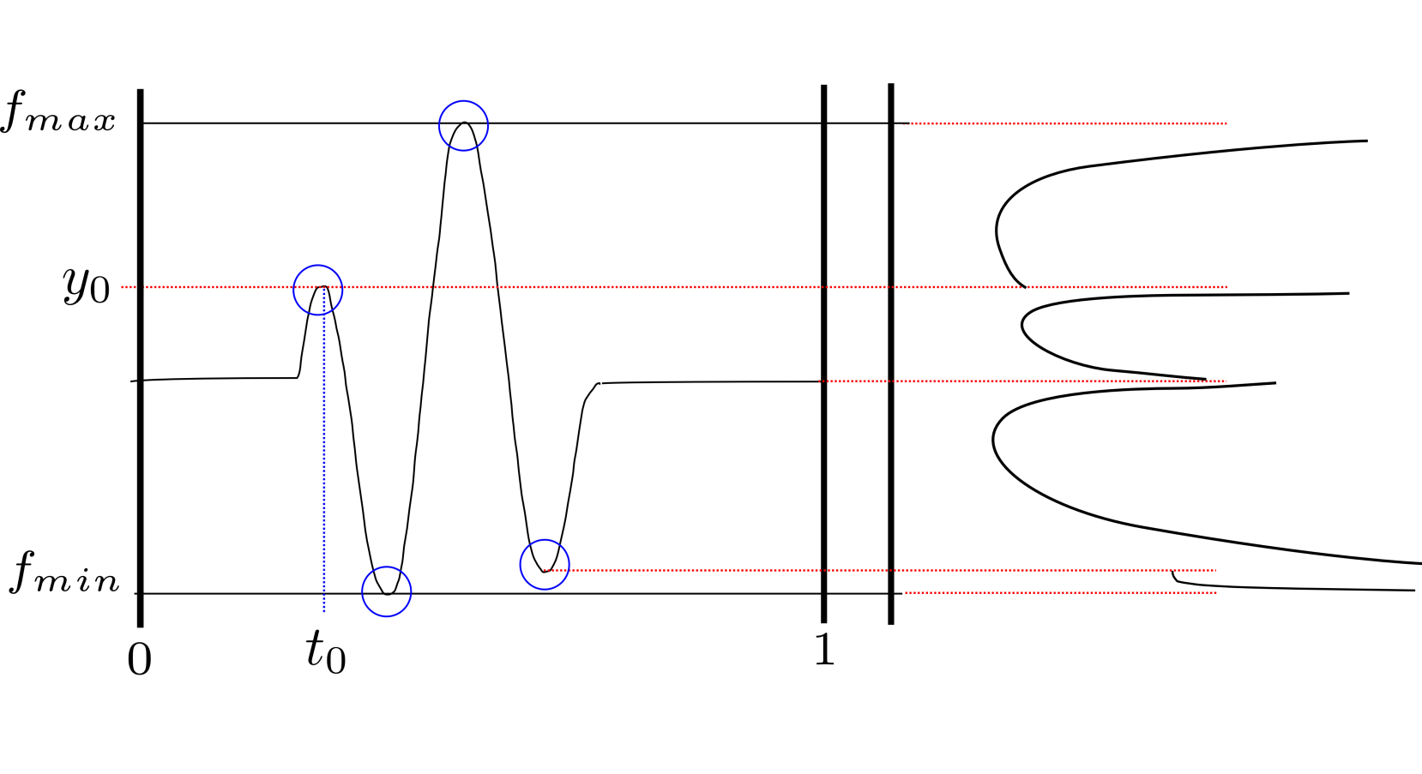
Density Function Singularities

Slide 46
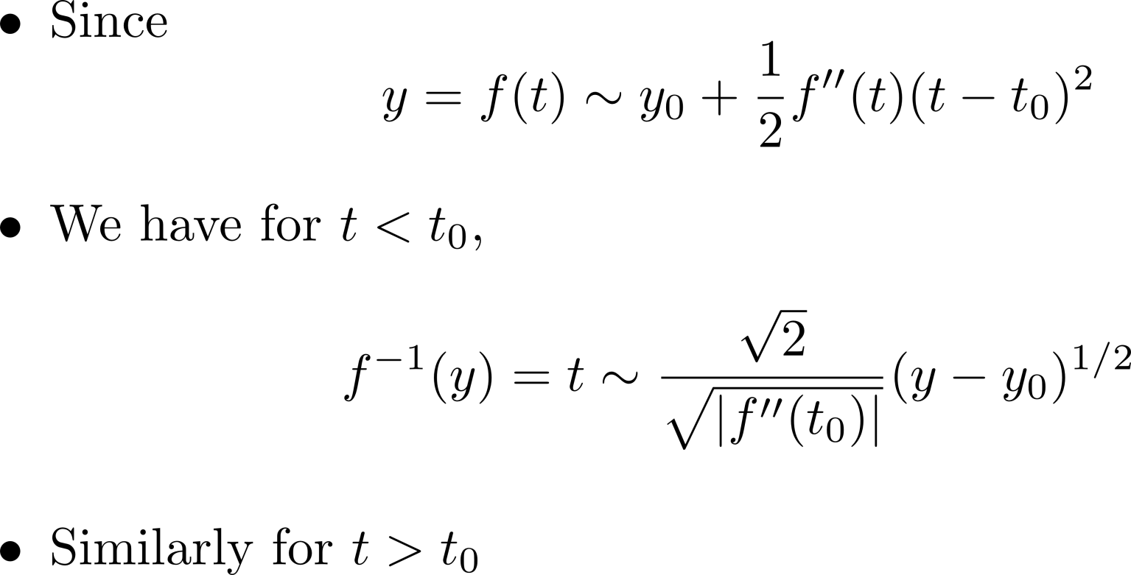
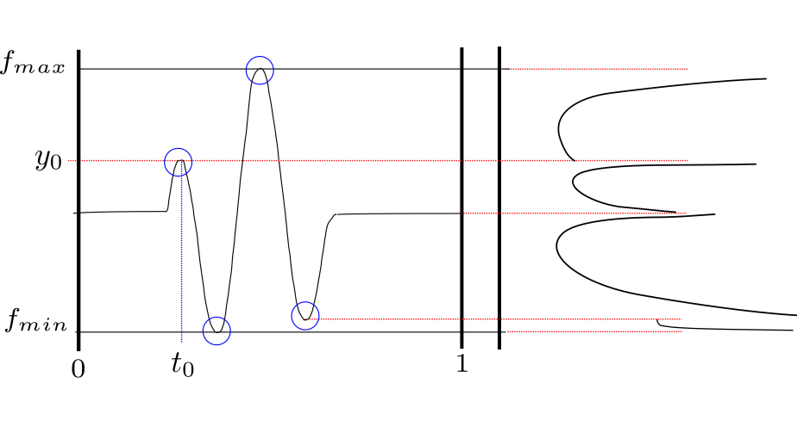
Density Function Singularities

Slide 47
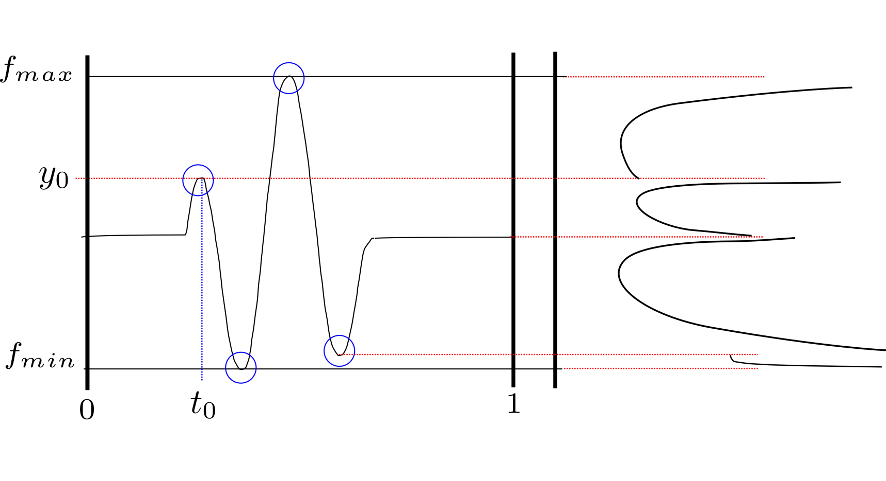
Density Function Singularities

Slide 48
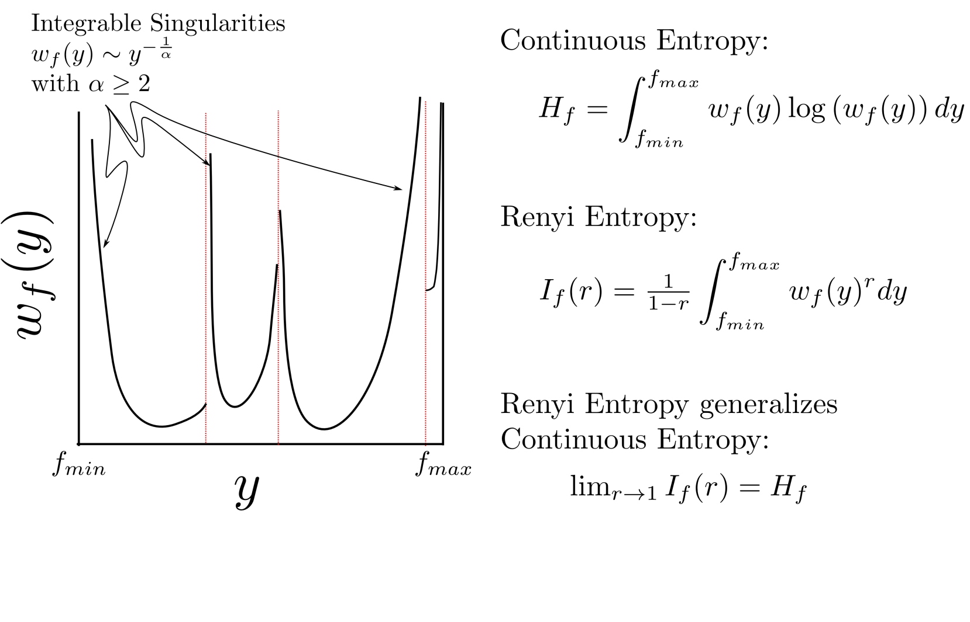
Entropy Calculations: Transition to Renyi Entropy

Slide 49
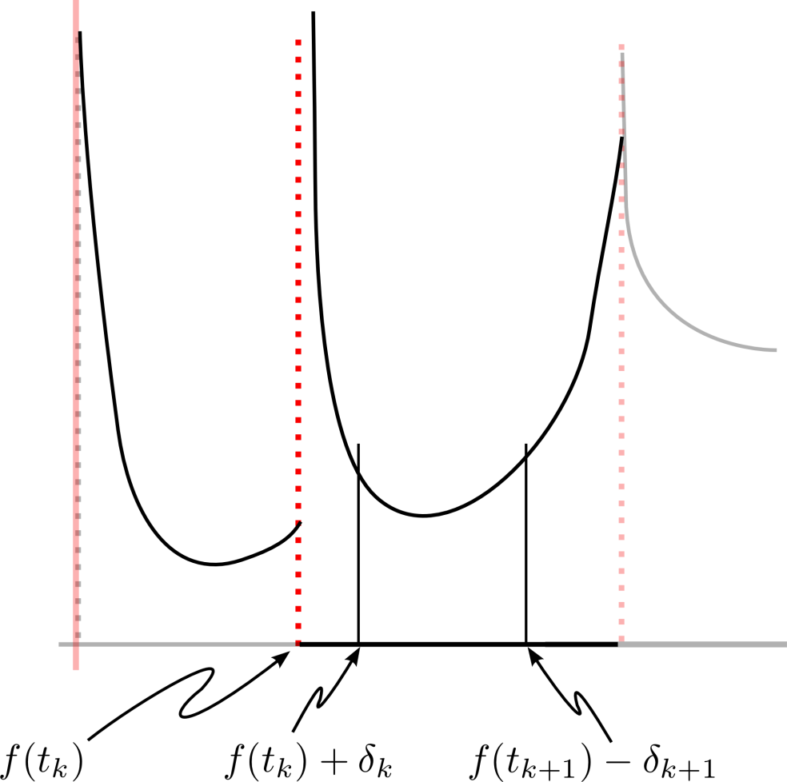
Asymptotic Form as

Slide 50
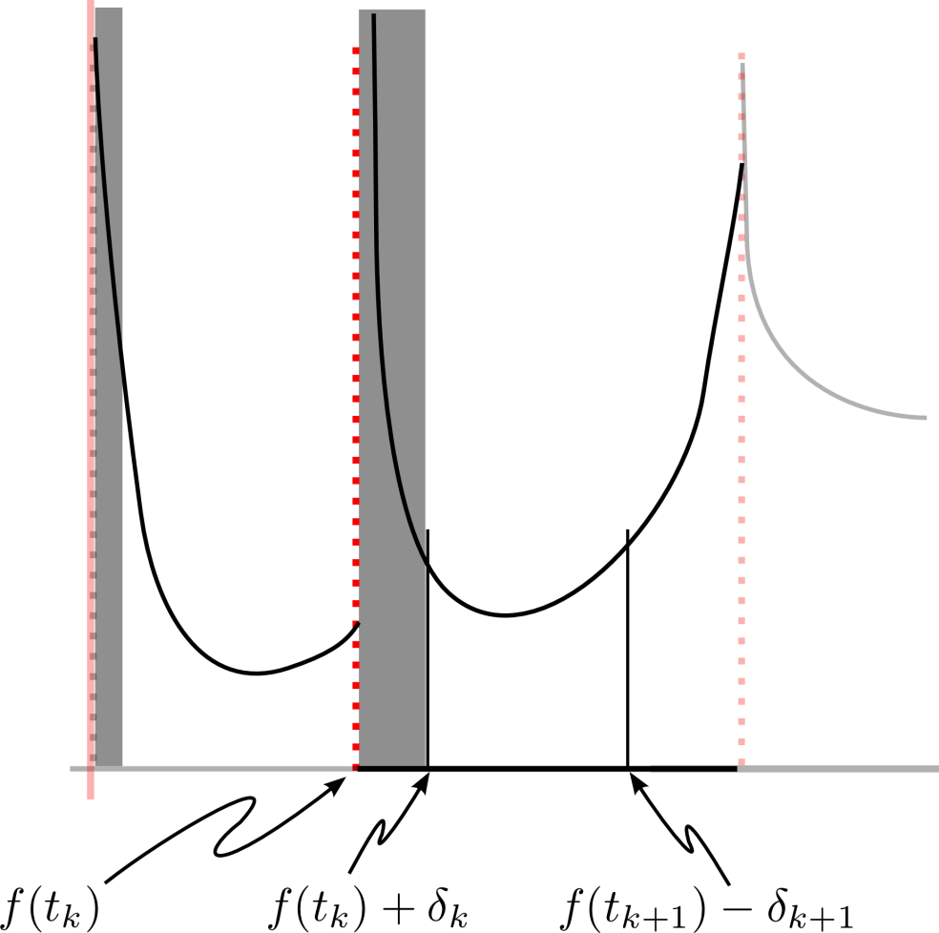
Asymptotic Form as

Slide 51
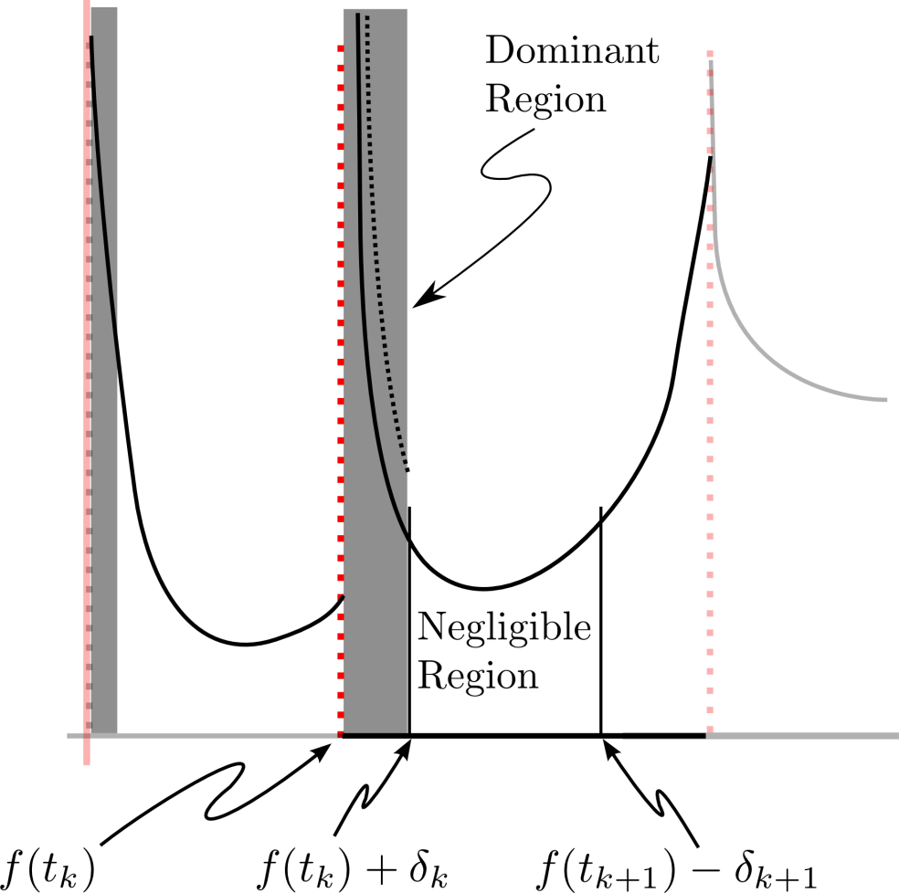
Asymptotic Form as

Slide 52
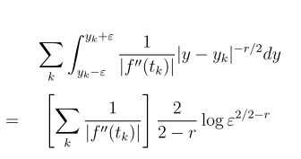
Asymptotic Form as r → 2

Slide 53
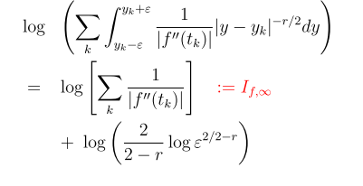
Asymptotic Form as r → 2

Slide 54
Non-destructive Evaluation of Graphite-Epoxy Composites
Materials Characterization: Entropy detects Flaws that are invisible to conventional techniques
All Processing is done independently on RF Segments
No Gates or Spatial Information is used

Slide 55
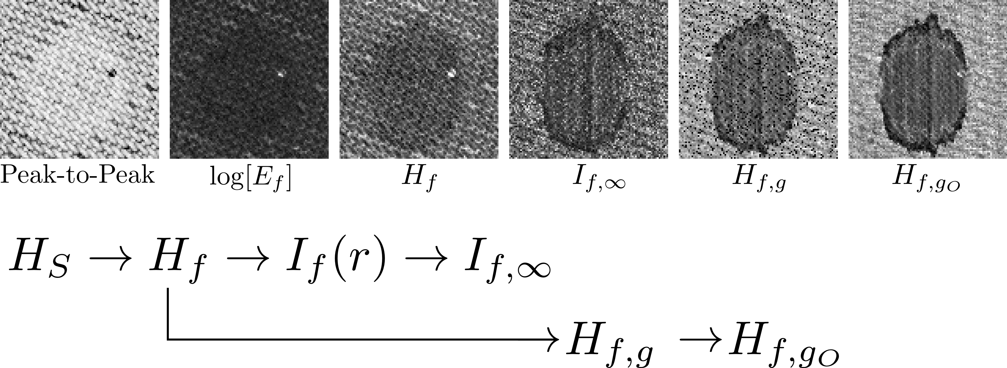
The Different Entropies

Slide 56
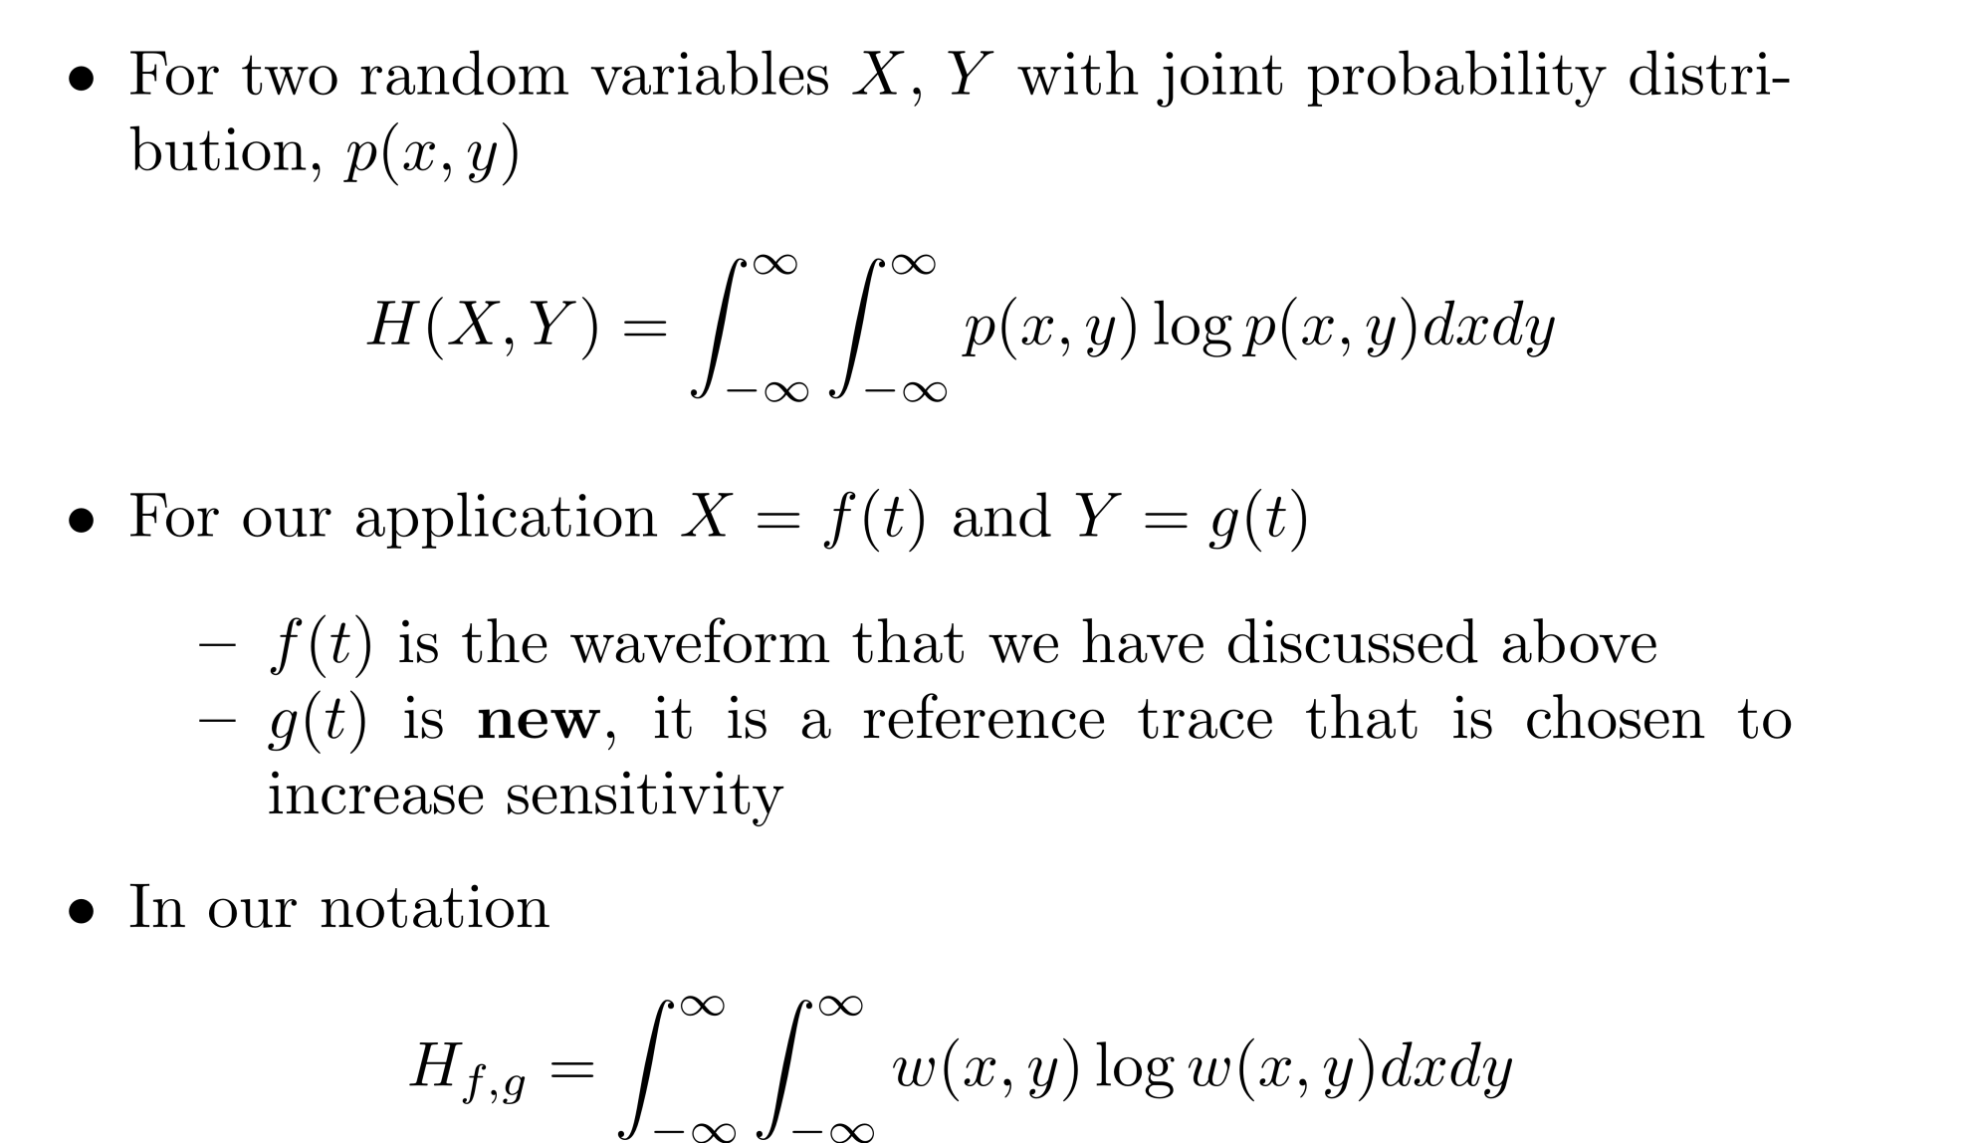
Joint Entropy

Slide 57
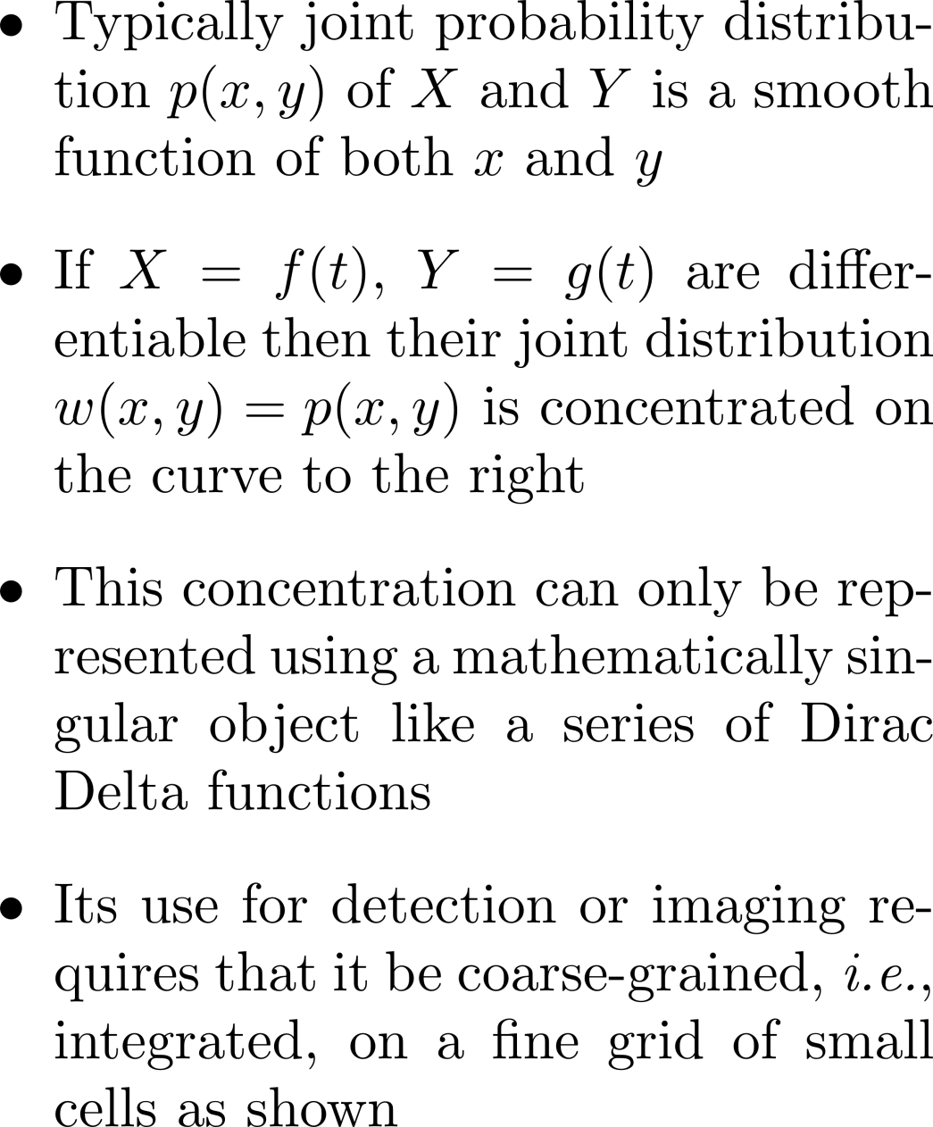
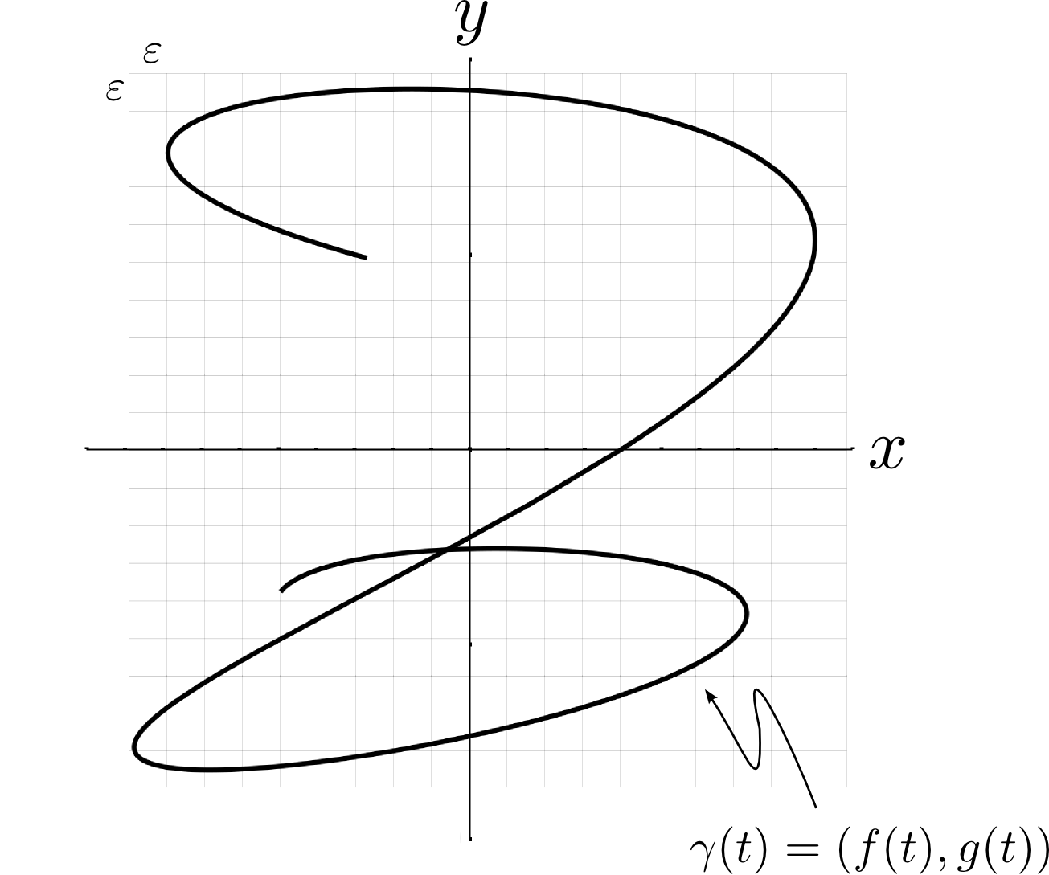
Joint Entropy

Slide 58
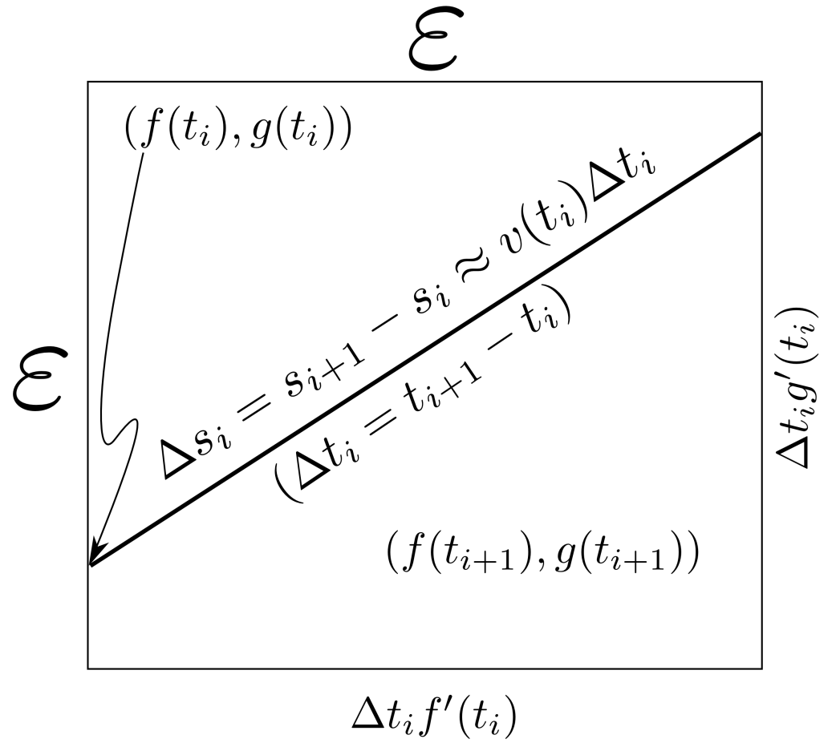
Joint Entropy

Slide 59
Joint Entropy

Slide 60
Different pictures

Slide 61
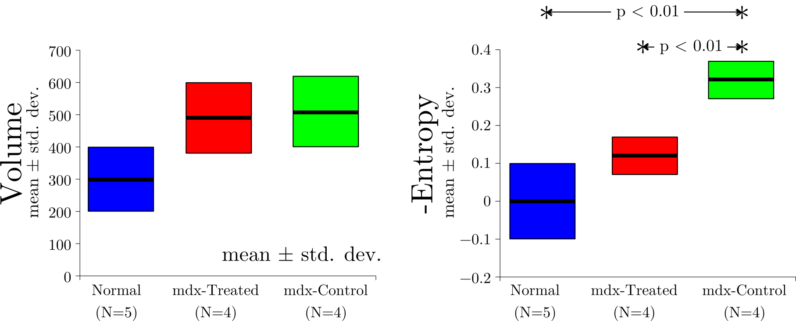
Therapy Monitoring
Medical Diagnosis: Entropy is more sensitive to therapeutic effects than conventional techniques
Note:
All Processing is done independently on RF Segments
No Gates or Spatial Information is used
Effect of Steroid Treatment in MDx Mice

Slide 62
Therapy Monitoring
Medical Diagnosis: Entropy is more sensitive to therapeutic effects than conventional techniques
Note:
All Processing is done independently on RF Segments
No Gates or Spatial Information is used
Effect of Steroid Treatment in MDx Mice

Slide 63
Tissue Characterization
Medical Diagnosis: Entropy is more sensitive to therapeutic effects than conventional techniques
Note:
All Processing is done independently on RF Segments
No Gates or Spatial Information is used
Diagnosis of DMD in Humans

Slide 64
Tissue Characterization
Medical Diagnosis: Entropy is more sensitive to therapeutic effects than conventional techniques
Note:
All Processing is done independently on RF Segments
No Gates or Spatial Information is used
Diagnosis of DMD in Humans

Slide 65
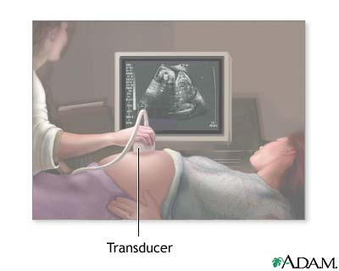
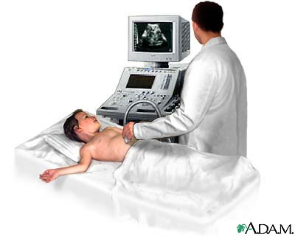
All Detection is Based on Waves
Medical Scanners:
Ultrasound, PET, SPECT
Developed a suite of algorithms that work in the Medical domain
The systems are characterized by high signal loss
Attenuating materials
Non planar interfaces scatter waves away from the sensor
Must compensate for motion during acquisition
We have developed fully automatic algorithms that meet these challenges
Robust in the presence of noise
Fast enough to operate on multi GigaByte data sets
Automatically segment data sets into segments of different relative importance
Produce quantitative performance metrics to aid medical treatment process
Superior to conventional techniques
These are general enough to be applicable in other problem domains

Slide 66
All Detection is Based on Waves
Medical Scanners:
Ultrasound, PET, SPECT
Developed a suite of algorithms that work in the Medical domain
The systems are characterized by high signal loss
Attenuating materials
Non planar interfaces scatter waves away from the sensor
Must compensate for motion during acquisition
We have developed fully automatic algorithms that meet these challenges
Robust in the presence of noise
Fast enough to operate on multi GigaByte data sets
Automatically segment data sets into segments of different relative importance
Produce quantitative performance metrics to aid medical treatment process
Superior to conventional techniques
These are general enough to be applicable in other problem domains
Notes:
Mention that we are talking about backscatter measurements in all of the applications and examples

Slide 67
All Detection is Based on Waves
Medical Scanners:
Ultrasound, PET, SPECT
Developed a suite of algorithms that work in the Medical domain
The systems are characterized by high signal loss
Attenuating materials
Non planar interfaces scatter waves away from the sensor
Must compensate for motion during acquisition
We have developed fully automatic algorithms that meet these challenges
Robust in the presence of noise
Fast enough to operate on multi GigaByte data sets
Automatically segment data into subsets of different relative importance
Produce quantitative performance metrics to aid medical treatment process
Typically more sensitive than energy-based techniques
These are general enough to be applicable in other problem domains

Slide 68
All Detection is Based on Waves
Developed a suite of algorithms that work in the Medical domain
The systems are characterized by high signal loss
Attenuating materials
Non planar interfaces scatter waves away from the sensor
Must compensate for motion during acquisition
Noise-Normalized
Energy
Noise- Normalized
Entropy
A
A
We have developed fully automatic algorithms that meet these challenges
Robust in the presence of noise
Fast enough to operate on multi GigaByte data sets
Automatically segment data into subsets of different relative importance
Produce quantitative performance metrics to aid medical treatment process
Typically more sensitive than energy-based techniques. i.e., noise-normalized or confidence values are greater if entropy analysis is used
These are general enough to be applicable in other problem domains

Slide 69
All Detection is Based on Waves
Medical Scanners:
Ultrasound, PET, SPECT
Developed a suite of algorithms that work in the Medical domain
The systems are characterized by high signal loss
Attenuating materials
Non planar interfaces scatter waves away from the sensor
Must compensate for motion during acquisition
We have developed fully automatic algorithms that meet these challenges
Robust in the presence of noise
Fast enough to operate on multi GigaByte data sets
Automatically segment data into subsets of different relative importance
Produce quantitative performance metrics to aid medical treatment process
Typically more sensitive than energy-based techniques
These are general enough to be applicable in other problem domains

Slide 70
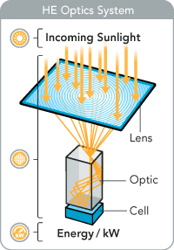
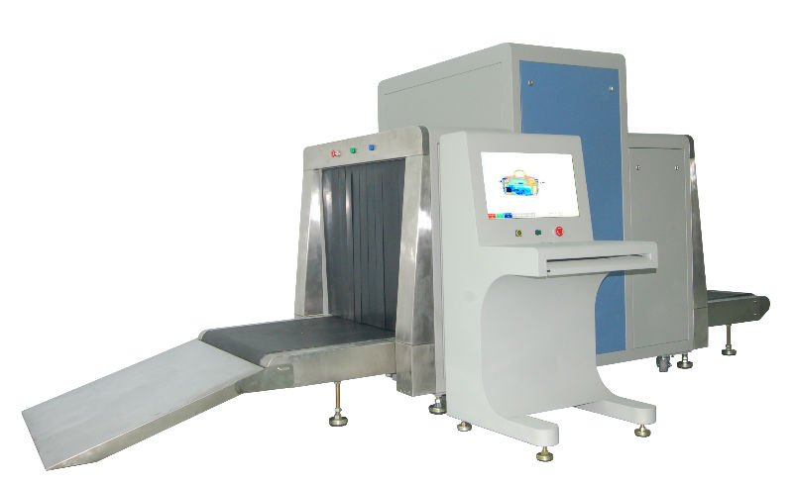
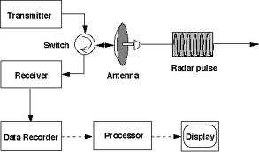
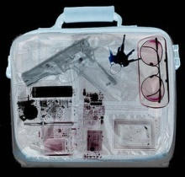
All Detection is Based on Waves
Medical Scanners:
Ultrasound, PET, SPECT
Optical Systems:
Cameras, microscopes,
telescopes
Radar Systems:
Air flight control,
Remote sensing
Security Systems and NDT:
Airport scanners

Slide 71
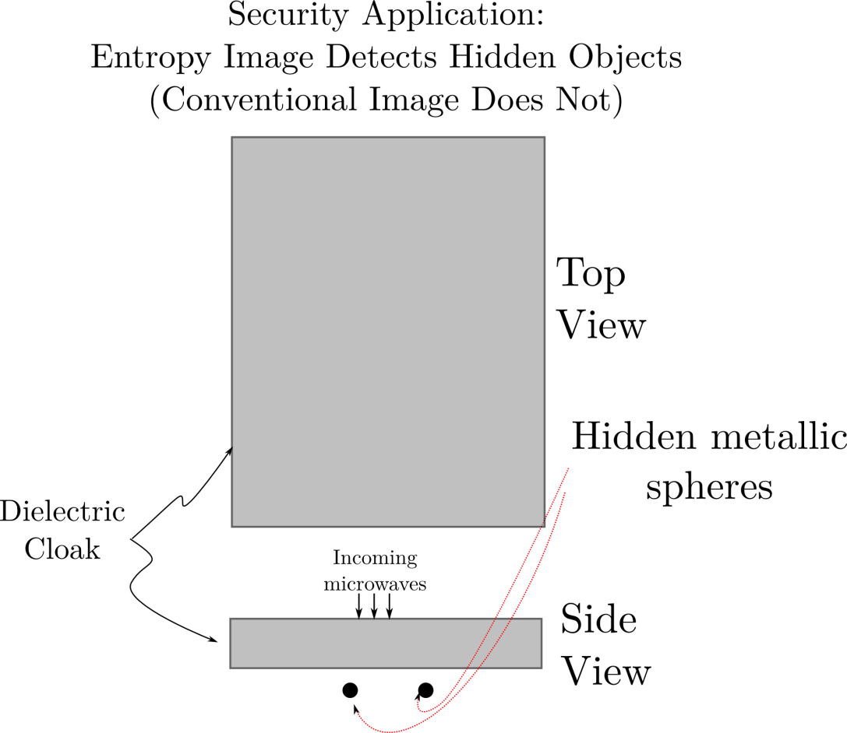
Microwave Threat Detection
Security Scanning and Threat Detection: Entropy detects hidden security threats that are invisible to conventional scans

Slide 72
Microwave Threat Detection
Security Scanning and Threat Detection: Entropy detects hidden security threats that are invisible to conventional scans

Slide 73
Microwave Threat Detection
Security Scanning and Threat Detection: Entropy detects hidden security threats that are invisible to conventional scans

Slide 74
Microwave Threat Detection
Security Scanning and Threat Detection: Entropy detects hidden security threats that are invisible to conventional scans

Slide 75
Microwave Threat Detection
Security Scanning and Threat Detection: Entropy detects hidden security threats that are invisible to conventional scans

Slide 76
Acoustic Firearm Classification

Slide 82
Summary
Entropy imaging can detect objects that are not visible in energy-based images
NDT
Medical
Threat detection, Security systems

Slide 83
Future Work
Joint Entropy with multiple references
Optimum reference
Applications to other data sources and types of problems

Slide 84
References
Entropy vs. Energy Waveform Processing: A Comparison Based on the Heat Equation, M.S. Hughes, J.E. McCarthy, P. Bruillard, J.N. Marsh, S.A. Wickline, Entropy, 17 [2015] 3518-3551
2. Joint-Entropy of Continuously Diﬀerentiable Ultrasonic Waveforms, M.S. Hughes, J.E. McCarthy, J.N. Marsh, S.A. Wickline, J. Acoustical Society of America, 133 (1) [2013] 283-300
3. Improved Signal Processing to Detect Cancer by Ultrasonic Molecular Imaging of Targeted Nanoparticles, M.S. Hughes, J. Marsh, J.E. McCarthy, M.V. Wickerhauser, B. Maurizi, K. Wallace, G. Lanza, S.A. Wickline, J. Acoustical Society of America, 129(6)[2011] 3756-3767
4. Real-time calculation of a limiting form of the Renyi entropy applied to detection of subtle
changes in scattering architecture, M.S. Hughes, J.E. McCarthy, M. V. Wickerhauser, J.N.
Marsh, J.M. Arbeit, R.W. Fuhrhop, K.D. Wallace, T. Thomas, J. Smith, K. Agyem, G.M.
Lanza, S.A. Wickline, J. Acoustical Society of America, Vol. 126, [2009] 2350-2358
5. Properties of an Entropy-based Signal Receiver with an Application to Ultrasonic Molecular
Imaging, M. S. Hughes, J. E. McCarthy, J. N. Marsh, J. M. Arbeit, R. G. Neumann, R. W.
Fuhrhop, K. D. Wallace, D. R. Znidersic, B. N. Maurizi, S. L. Baldwin, G. M. Lanza, S.
A. Wickline, J. Acoustical Society of America, 121 [2007] 3542-3557

Slide 86
Automated Signal Detection

Slide 87
Established Application of Information Theory

Slide 88
Intrinsic Information…

